Slide 1
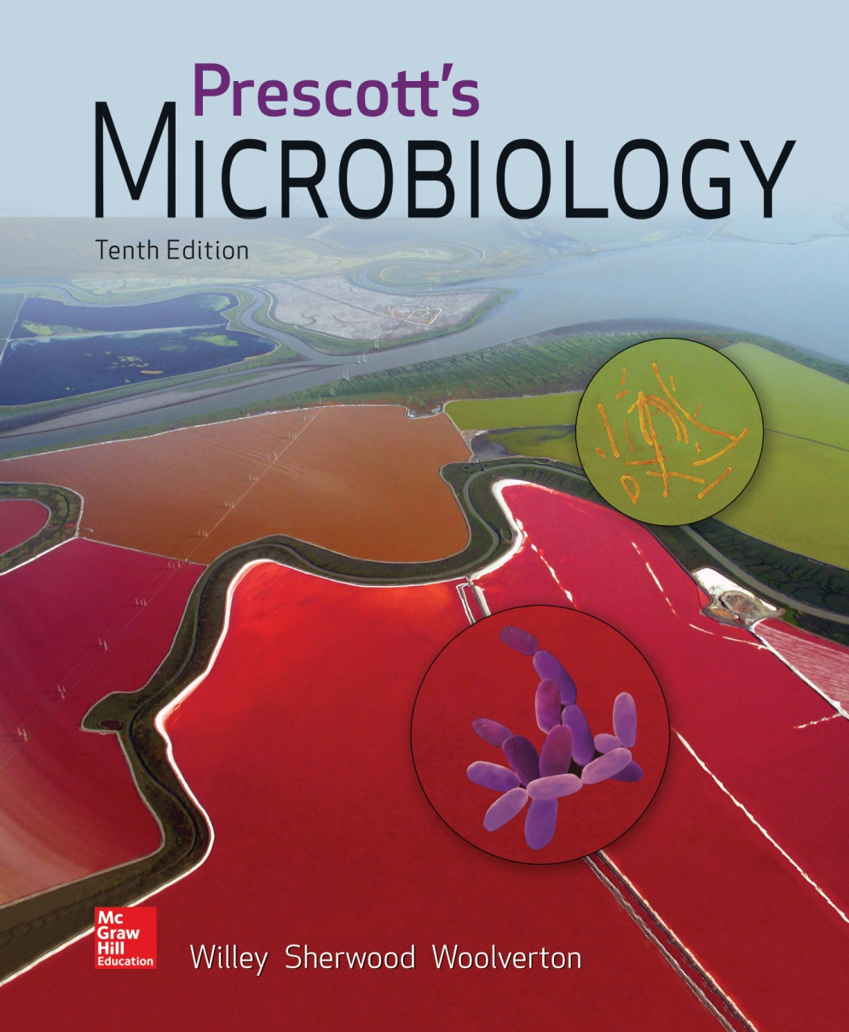
Chapter 7 – Microbial Growth

Slide 2
7.1 Most Bacteria and Archaea Reproduce By Binary Fission
Describe binary fission as observed in bacteria and archaea
Compare the three reproductive strategies used by bacteria with binary fission

Slide 3
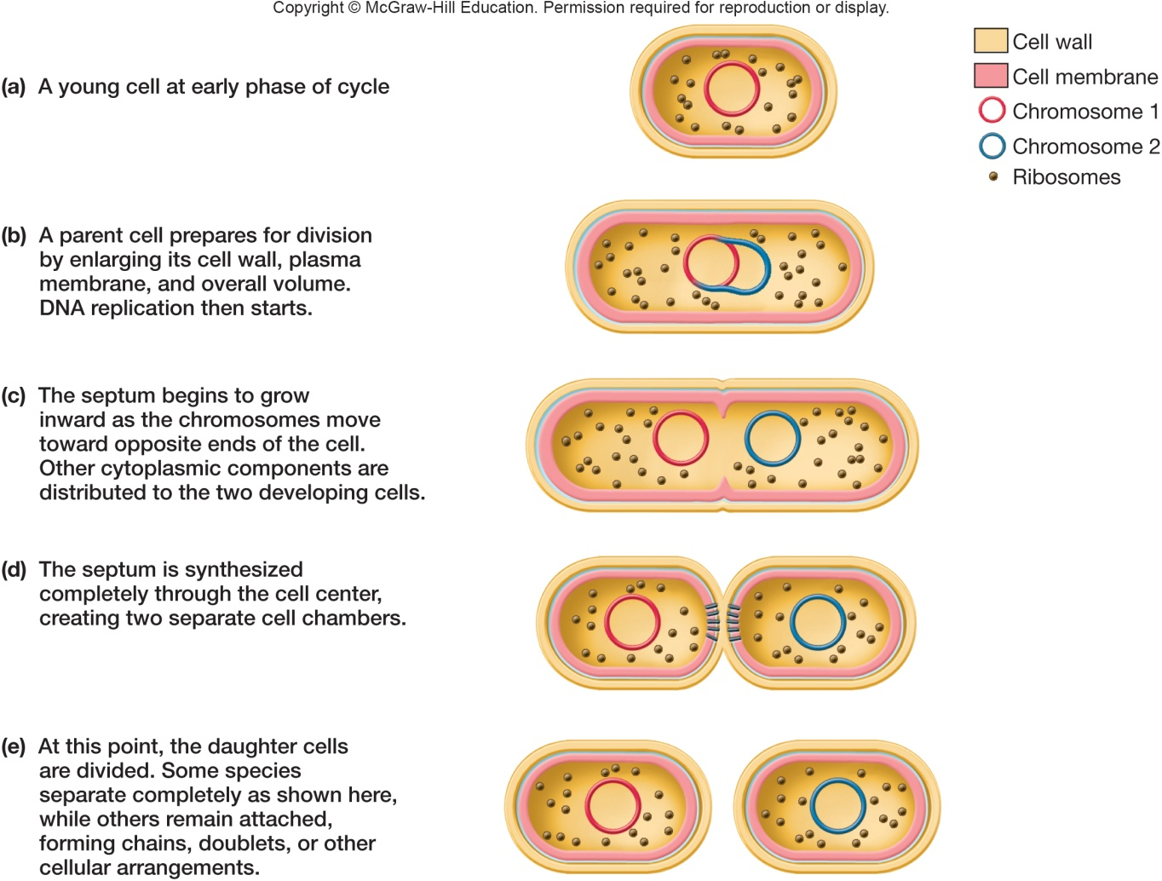
Reproductive Strategies
The reproductive strategies of eukaryotic microbes
asexual and sexual, haploid or diploid
Bacteria and Archaea
haploid only, asexual - binary fission, budding, filamentous
all must replicate and segregate the
genome prior to
division

Slide 4
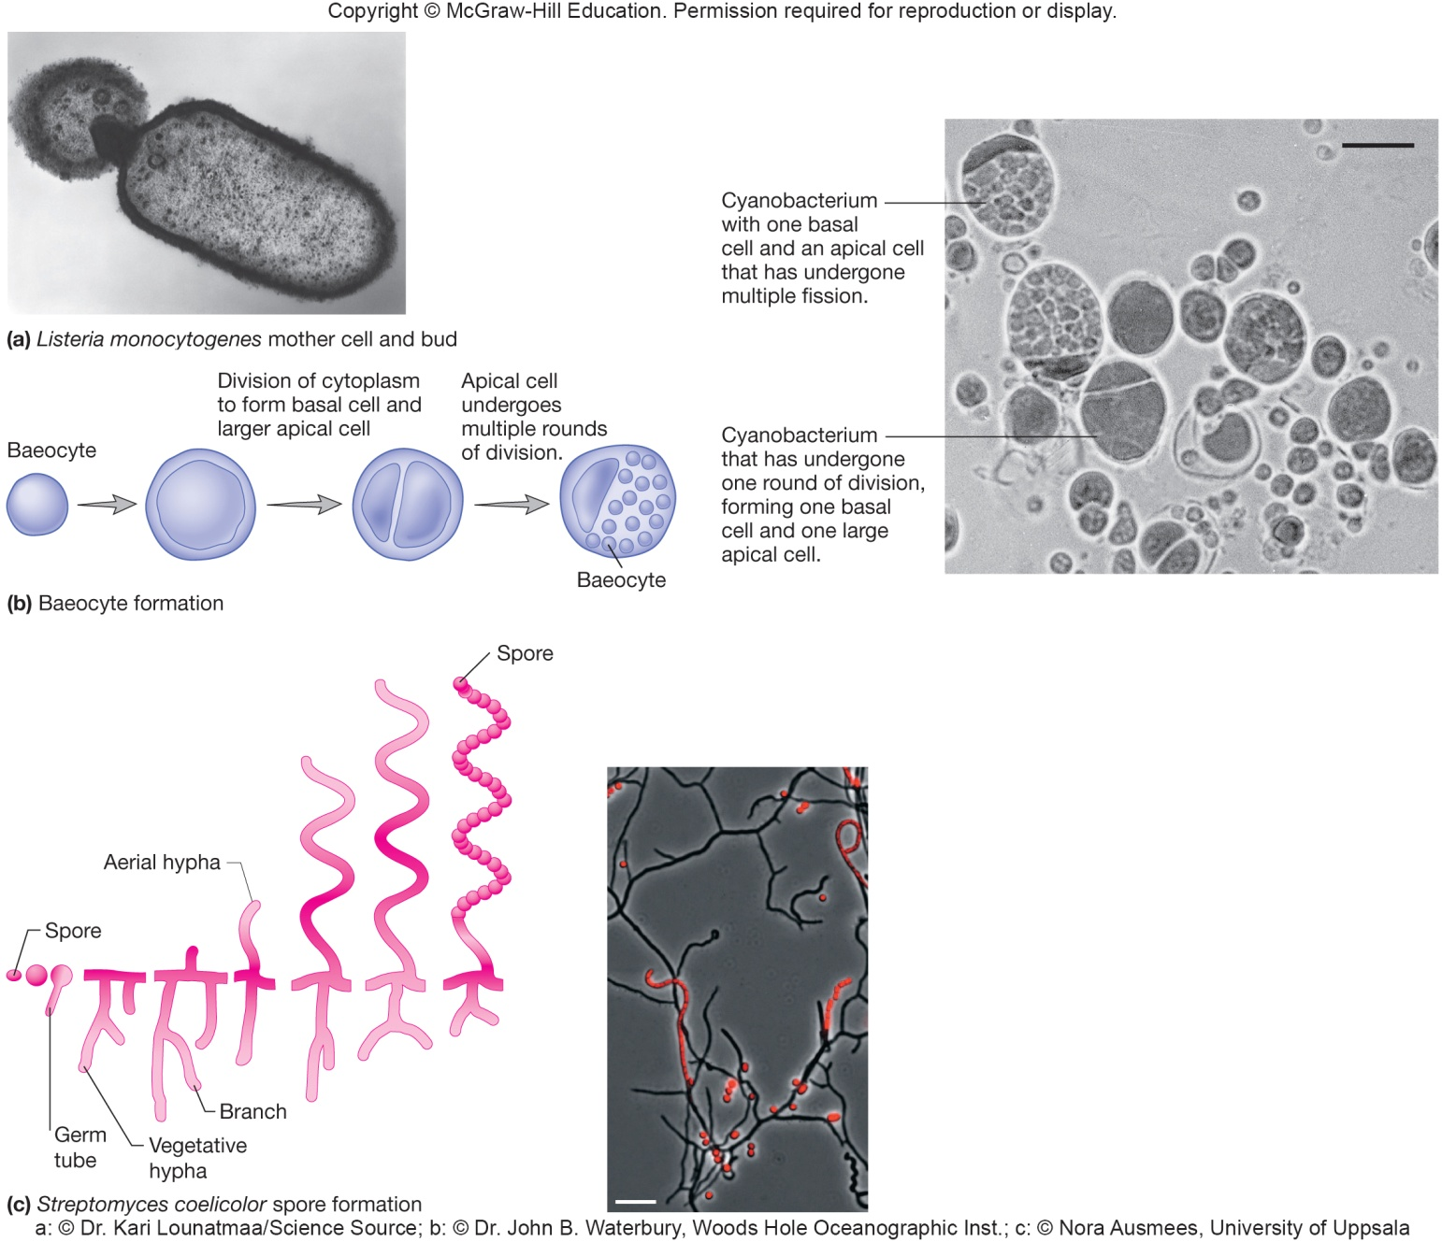
Bacterial Reproduction Methods Different From Binary Fission

Slide 5
7.2 Bacterial Cell Cycles Can Be Divided Into Three Phases
Summarize the three phases in a typical bacterial cell cycle
Summarize current models for chromosome partitioning
State the functions of cytoskeletal proteins during cytokinesis and in determining cell shape

Slide 6
Bacterial Cell Cycle
Cell cycle is sequence of events from formation of new cell through the next cell division
most bacteria divide by binary fission
Two pathways function during cycle
DNA replication and partition
cytokinesis

Slide 7
Chromosome Replication and Partitioning
Most bacterial chromosomes are circular
Single origin of replication – site at which replication begins
Terminus – site at which replication is terminated, located opposite of the origin
Replisome – group of proteins needed for DNA synthesis
DNA replication proceeds in both directions from the origin
Origins move to opposite ends of the cell

Slide 8
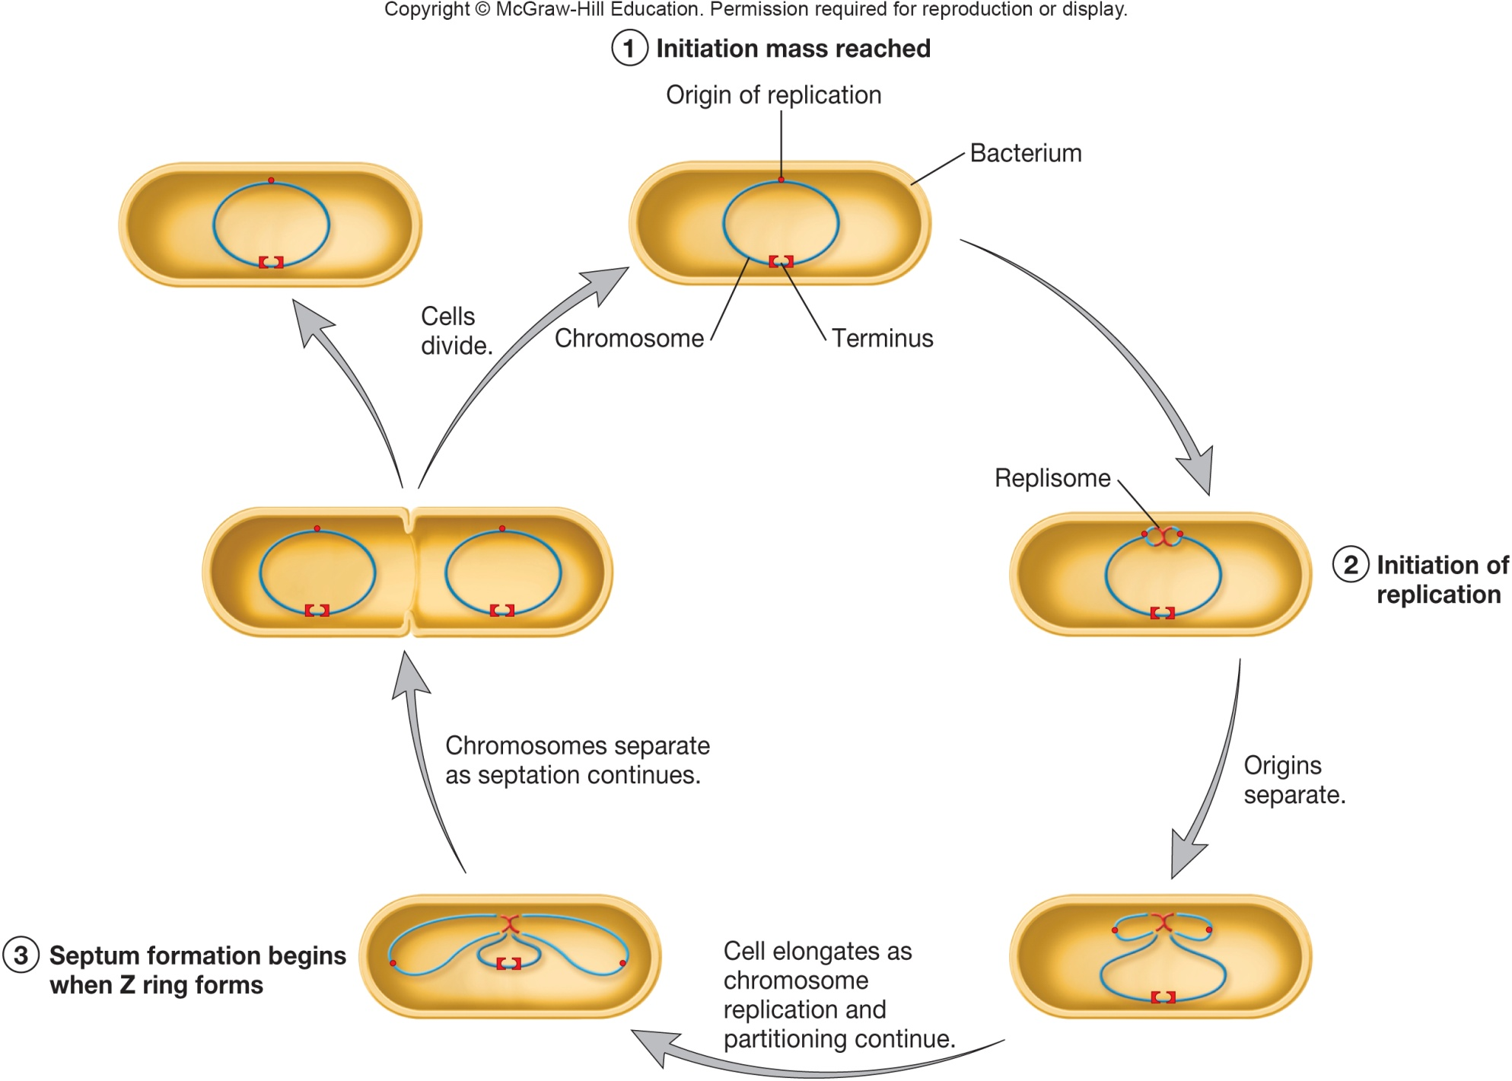
Cell Cycle of E. coli Bacteria

Slide 9
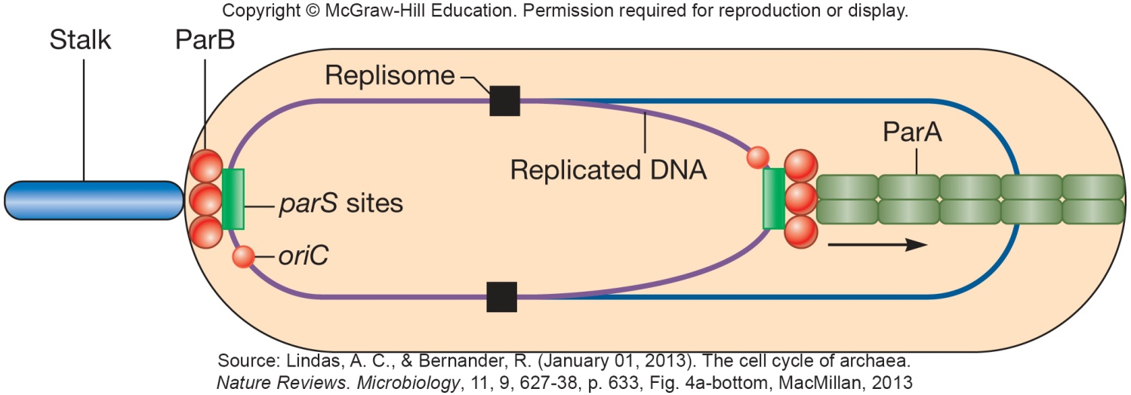
Chromosome Partitioning – An Example
Replisome pushes, or leads to condensation of, daughter chromosomes to opposite ends
ParA/ParB proteins in C. crescentus
ParA polymerizes to form filaments
ParB binds DNA at parS site near origin of replication; technically, ParB binds 2 copies of parS site since DNA has been replicated
ParA interaction with 1 of the 2 ParB/parS complexes causes it to depolymerize, pulling one copy of the DNA away
system in almost 70% of 400 sequenced bacterial genomes
more work remains to understand partitioning in bacteria

Slide 10
Cytokinesis - Septation
Septation – formation of cross walls between daughter cells
Several steps
selection of site for septum formation
assembly of Z ring (composed of protein FtsZ
assembly of cell wall synthesizing machinery
constriction of cell and septum formation

Slide 11
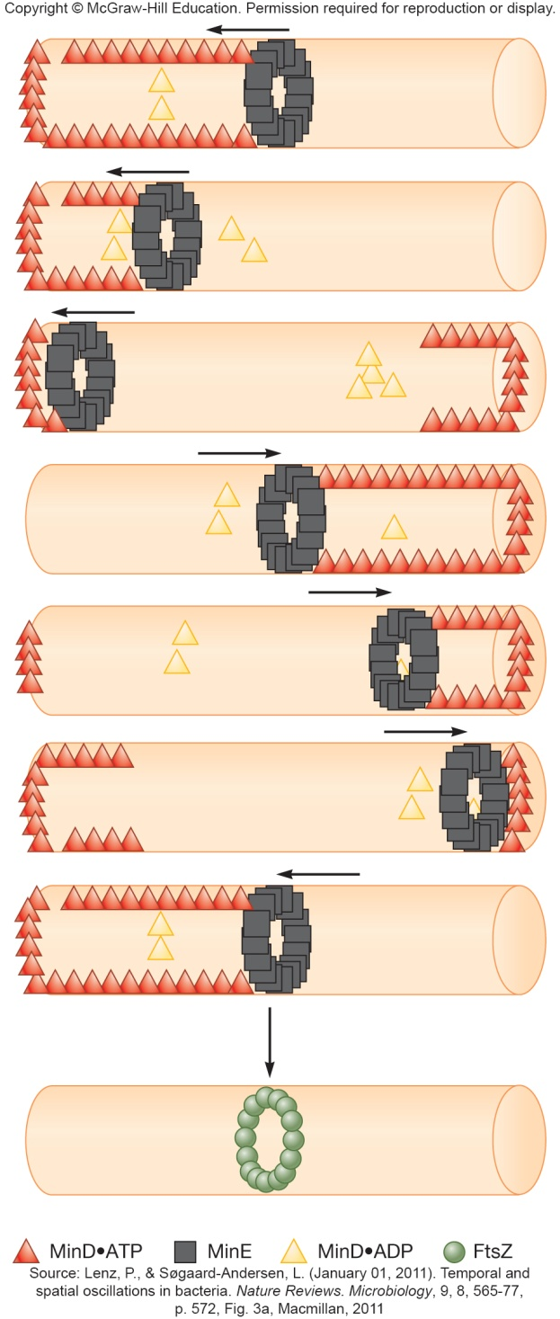
Z Ring Formation - Role in Septation
Protein FtsZ
tubulin homologue, found in most bacteria and archaea
polymerization forms Z ring, filaments of meshwork
MinCDE system in E. coli limits Z ring to cell center
MinC, MinD, MinE oscillate from one side of cell to other
high concentration of MinC at poles prevents formation of Z ring at those locations

Slide 12
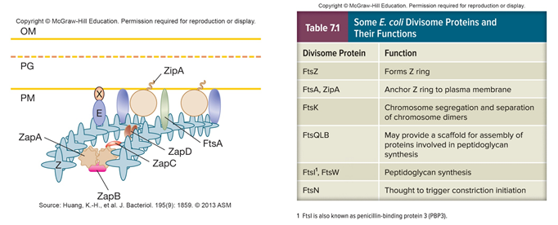
Divisome Formation
Anchoring proteins link Z ring to the plasma membrane
Cell wall-synthesizing machinery assembled
Constriction of the Z ring, invagination of the plasma membrane, and synthesis of septal wall complete division

Slide 13
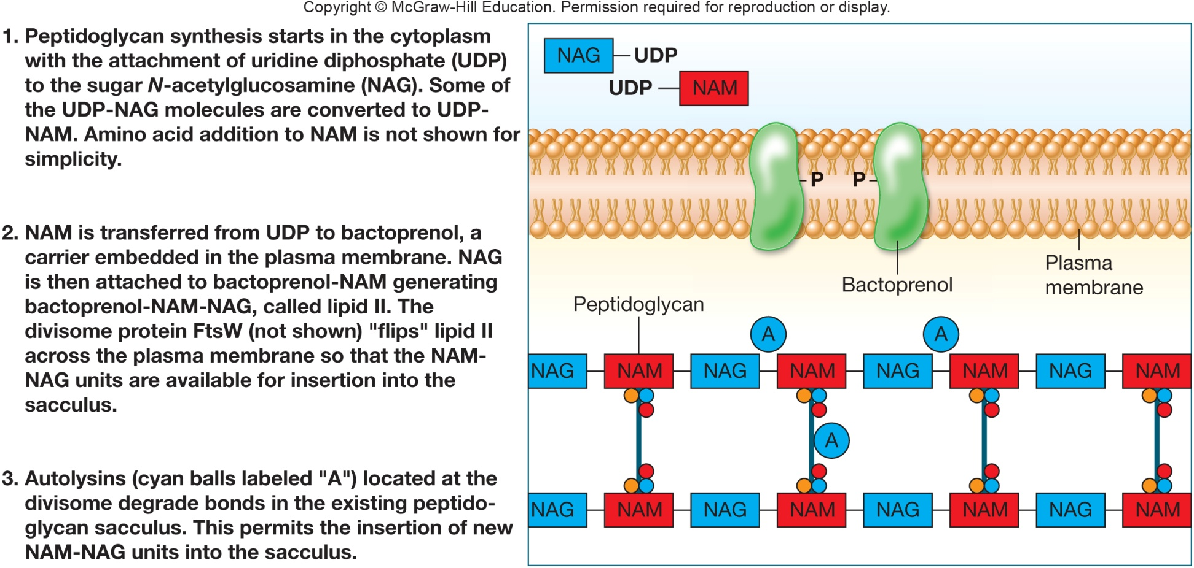
Cellular Growth and Determination of Cell Shape
Determined by peptidoglycan synthesis in bacteria
penicillin binding proteins (PBPs) – link peptidoglycan strands and catalyze controlled degradation for new growth
autolysins – PBP enzymes that degrade peptidoglycan at site where new units are added

Slide 14
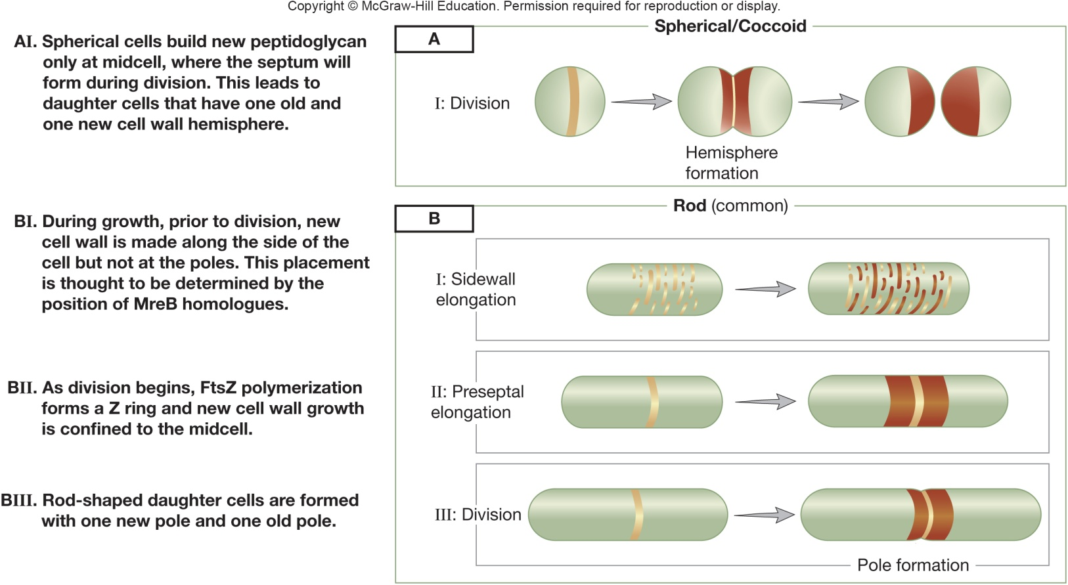
Cell Wall Growth and Cell Shape Determination
Cocci divisome - new peptidoglycan forms only at septum
FtsZ determines site of cell wall growth
FtsZ may recruit PBPs for synthesis of septum
Rods are similar but elongate prior to septation
MreB determines cell diameter/elongation as Z ring forms

Slide 15
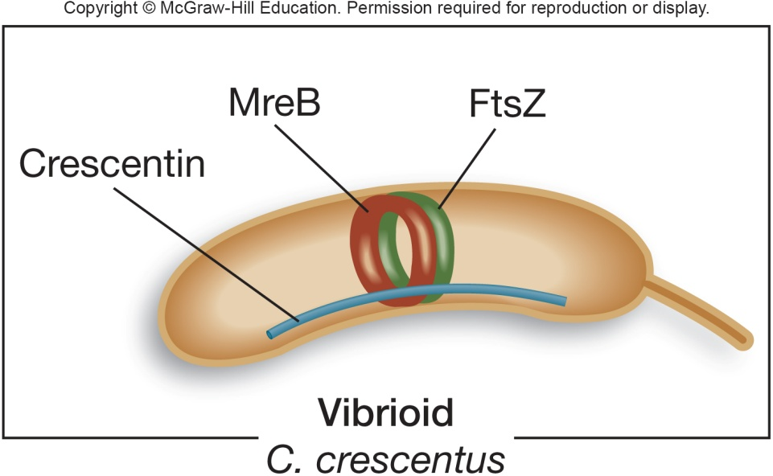
Vibrio Cell Wall Growth and Cell Shape Determination
Vibrio (comma-shaped bacteria)
FtsZ – forms Z ring
MreB – helical polymerization throughout cell
crescentin – intermediate filament homologue
localizes to short, curved side of cell
asymmetric cell wall synthesis forms curve

Slide 16
7.3 Some Archaeal Cell Cycles Resemble the Eukaryotic Cell Cycle
Compare and contrast the Sulfolobus spp. cell cycle and the typical eukaryotic cell cycle
Compare and contrast the Sulfolobus spp. cell cycle and a bacterial cell cycle
Identify the evidence suggesting that the Sulfolobus spp. cell cycle may not be universal among archaea

Slide 17
Archaeal Cell Cycles Resemble Eukaryal Cell Cycles – Except in Segregation of Chromosomes
Studies in Sulfolobus spp. indicate a cycle similar to a mitotic cycle
G1 growth phase followed by DNA replication (S phase), then G2 phase, segregation of chromosomes, and cytokinesis
segregation occurs via use of SegA/SegB protein system that is similar to bacterial partitioning systems
SegA similar in structure and function to ParA; SegB is unique to archaea, but thought to function similarly to ParB
DNA sequences similar to parS have yet to be found in archaea

Slide 18
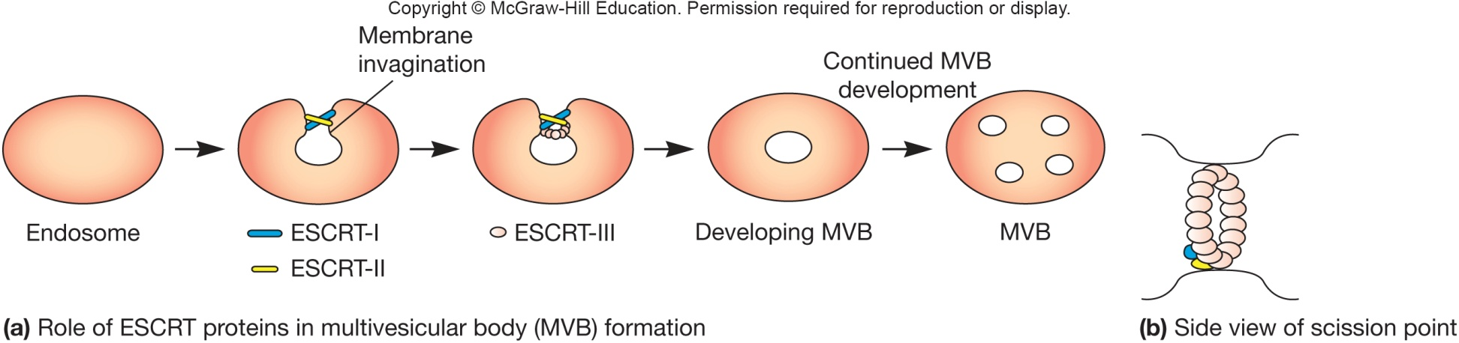
Archaeal Cytokinesis is Similar to Eukaryal Cytokinesis
Utilize proteins similar to ESCRT proteins of eukaryotes
endosomal sorting complex required for transport
form four distinct complexes involved in forming multivesicular bodies (MVB)
archaeal forms of ESCRT proteins include CdvA, CdvB, and CdvC, with homology in form/function to eukaryal versions

Slide 19
Don’t Jump to Conclusions on Archaeal Cell Cycle Information!
Information obtained so far has been produced from a limited number of archaeal species
Even then, contradictions exist
some archaea have no G2 phase
the SegAB system seems to be limited to Sulfolobus and a few members of the archaeal phylum Euryarchaeota
some archaea use a system similar to the bacterial MinD proteins for chromosome segregation
FtsZ proteins abound in archaea – a very bacterial process
Diversity in archaeal cell cycles is obvious and abundant, and more research needs to be performed to understand the systems more thoroughly

Slide 20
7.4 Environmental Factors Affect Microbial Growth
Use the terms that describe a microbe’s growth range or requirement for each of the factors that influence microbial growth
Summarize the adaptations of extremophiles to their natural habitats
Summarize the strategies used by nonextremophiles to acclimate to changes in their environment
Describe the enzymes observed in microbes that protect them against toxic O₂ products

Slide 21
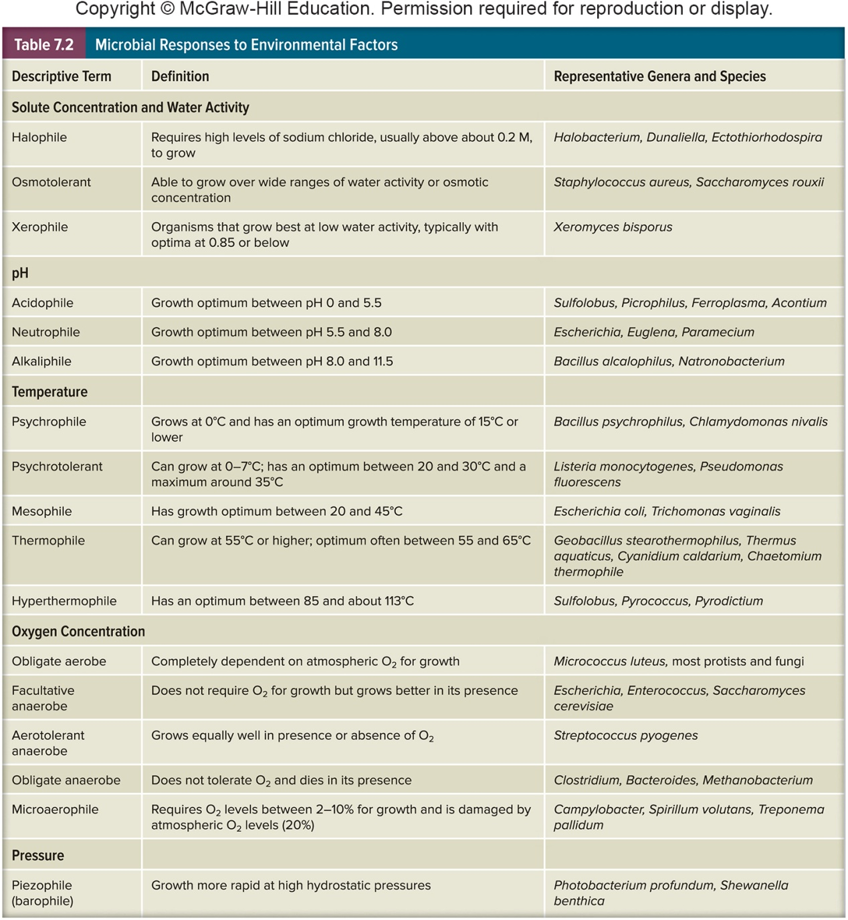
The Influence of Environmental Factors on Growth
Most organisms grow in fairly moderate environmental conditions
Extremophiles
grow under harsh conditions that would kill most other organisms

Slide 22
Solutes and Water Activity
Changes in osmotic concentrations in the environment may affect microbial cells
hypotonic solution (lower osmotic concentration)
water enters the cell
cell swells and may burst
hypertonic (higher osmotic concentration)
water leaves the cell
membrane shrinkage from cell wall (plasmolysis) may occur

Slide 23
Microbes Adapt to Changes in Osmotic Concentrations
Reduce osmotic concentration of cytoplasm in hypotonic solutions
mechanosensitive (MS) channels in plasma membrane allow solutes to leave
Increase internal solute concentration with compatible solutes to increase their internal osmotic concentration in hypertonic solutions
solutes compatible with metabolism and growth

Slide 24
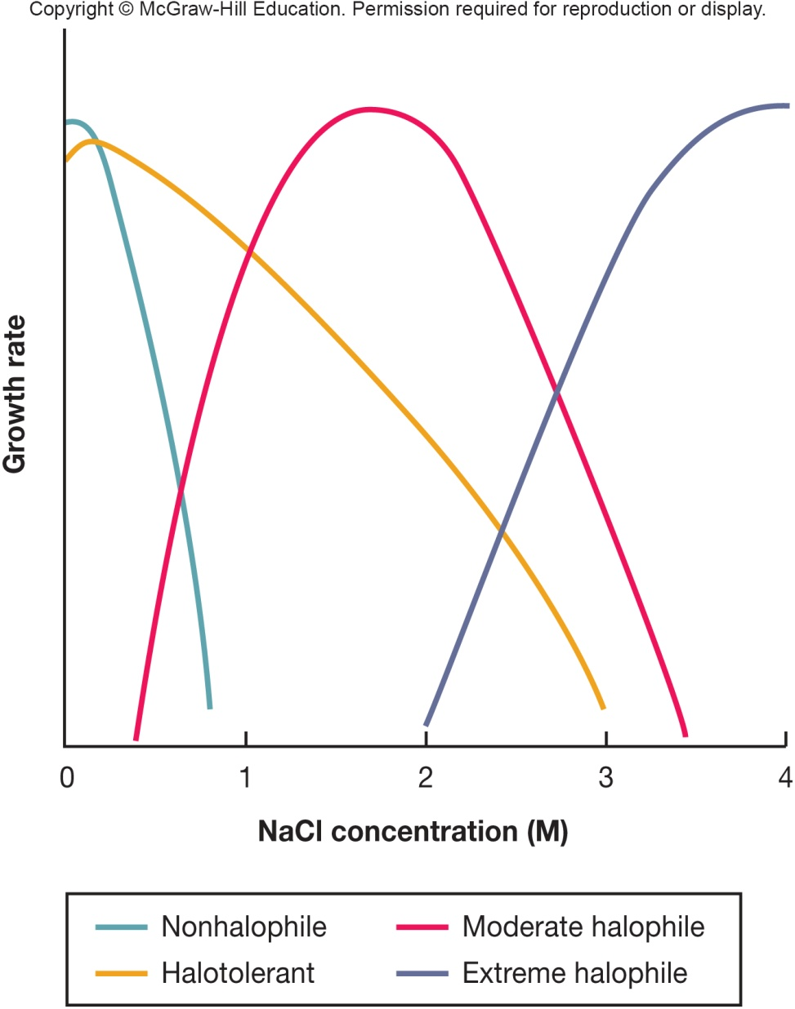
Extremely Adapted Microbes - Halophiles
Halophiles
grow optimally in the presence of NaCl or other salts at a concentration above about 0.2M
Extreme halophiles
require salt concentrations of 2M and 6.2M
extremely high concentrations of potassium
cell wall, proteins, and plasma membrane require high salt to maintain stability and activity

Slide 25
Solutes and Water Activity (2)
Water activity (a_{w})
water activity of a solution is 1/100 the relative humidity of solution
also equal to ratio of solution’s vapor pressure (Psoln) to that of pure water (Pwater)
A_{w} = Psoln/ Pwater
low water activity means most water is bound
Osmotolerant microbes can grow over wide ranges of water activity
amount of water available to organisms
reduced by interaction with solute molecules (osmotic effect)
higher [solute] ⇒ lower a_{w}
reduced by adsorption to surfaces (matric effect)

Slide 26
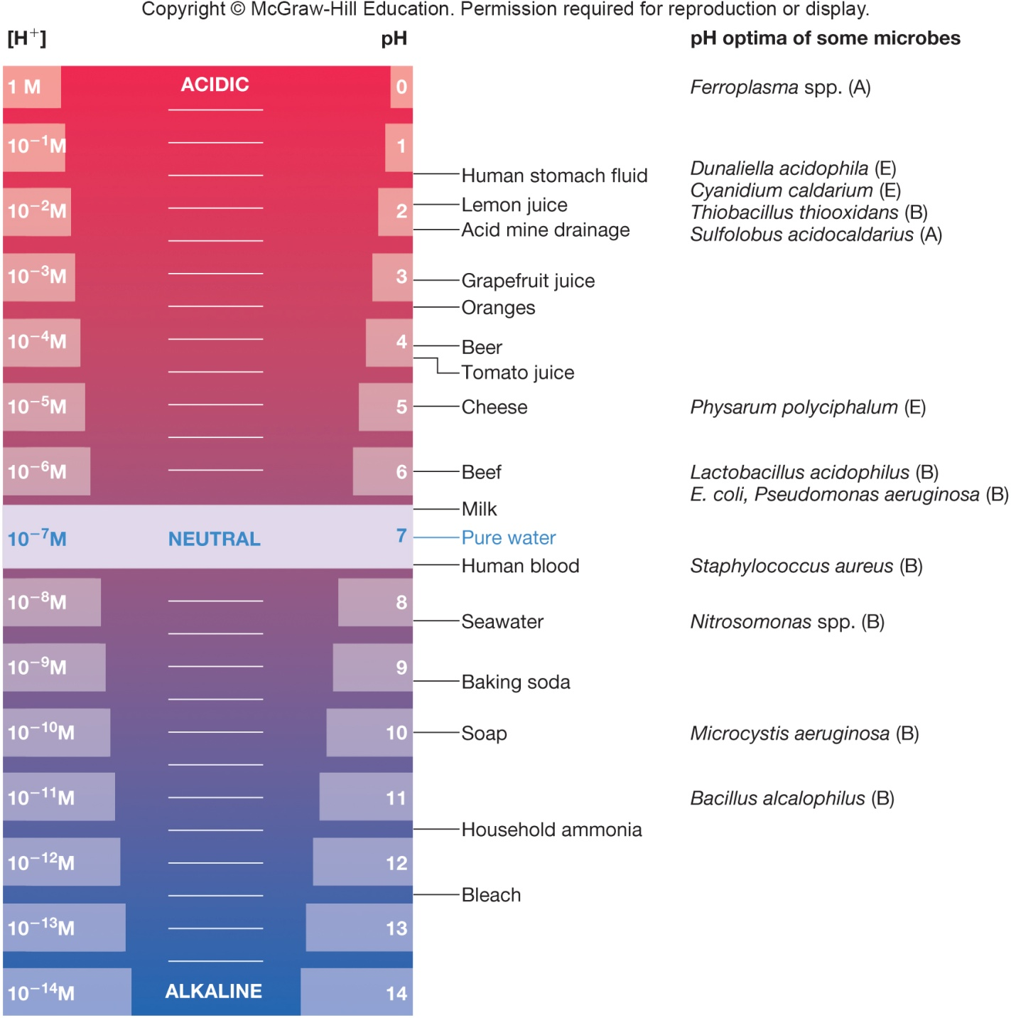
pH
Measure of the relative acidity of a solution
negative logarithm of the hydrogen ion concentration
Acidophiles
growth optimum between pH 0-5.5
Neutrophiles
growth optimum between pH 5.5-7
Alkaliphiles (alkalophiles)
growth optimum between pH 8.5-11.5

Slide 27
pH Tolerance Mechanisms of Microbes
Most microbes maintain an internal pH near neutrality
the plasma membrane is impermeable to proton
exchange potassium for protons
Acidic tolerance response
pump protons out of the cell
some synthesize acid and heat shock proteins that protect proteins
Many microorganisms change the pH of their habitat by producing acidic or basic waste products

Slide 28
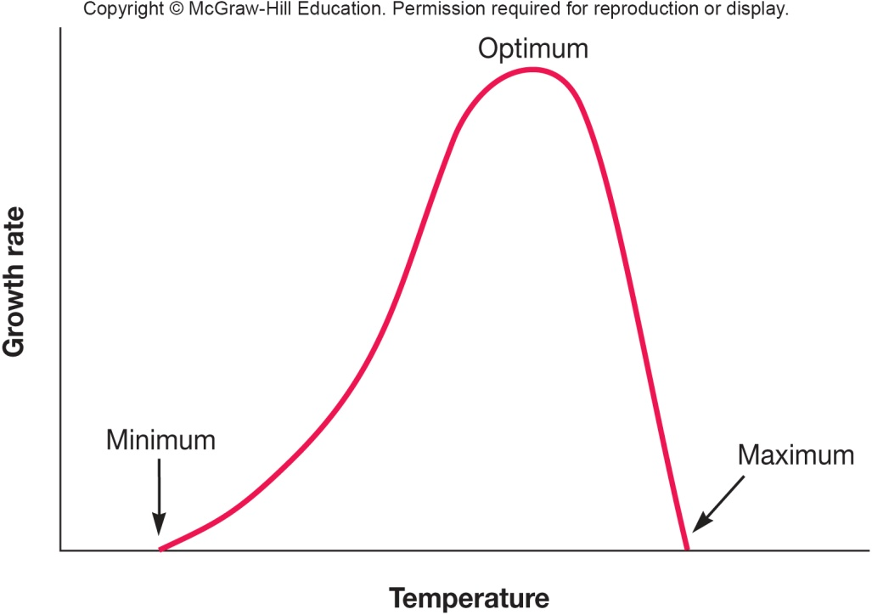
Temperature
Microbes cannot regulate their internal temperature
Enzymes have optimal temperature at which they function optimally
High temperatures may inhibit enzyme functioning and be lethal
Organisms exhibit distinct cardinal growth temperatures
minimal
maximal
optimal

Slide 29
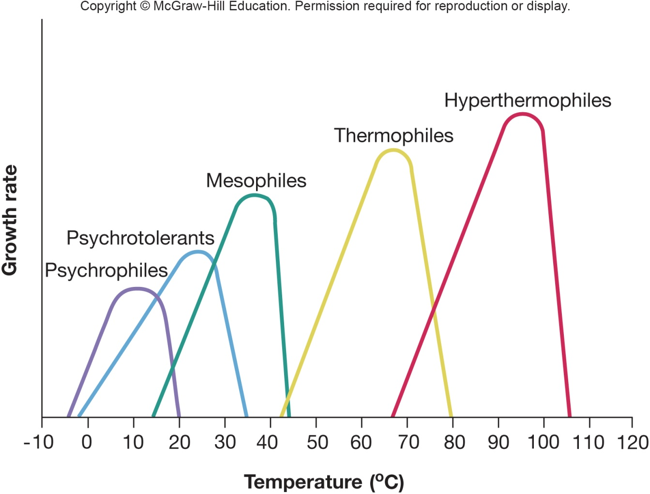
Temperature Ranges for Microbial Growth
Psychrophiles – 0º C to 20º C
Psychrotrophs – 0º C to 35º C
Mesophiles – 20º C to 45º C
Thermophiles – 55º C to 85º C
Hyperthermophiles – 85º C to 113º C

Slide 30
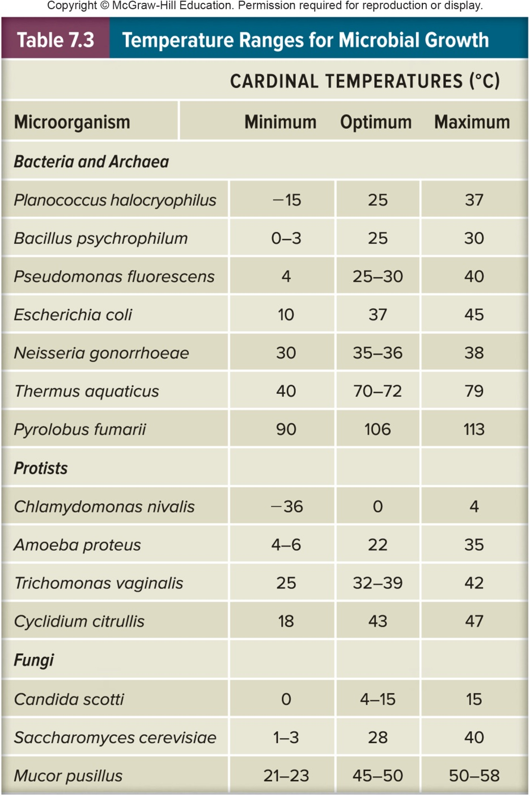
Adaptations of Thermophiles
Protein structure stabilized by a variety of means
e.g. more H bonds
e.g. more proline
e.g. chaperones
Histone-like proteins stabilize DNA
Membrane stabilized by variety of means
e.g. more saturated, more branched and higher molecular weight lipids
e.g. ether linkages (archaeal membranes)

Slide 31
Oxygen Concentration
Growth in presence of different oxygen concentrations depends on a microbe’s metabolic processes, electron transport chains (ETC), terminal electron acceptor used
aerobe: grows in presence of atmospheric oxygen (O₂) which is 20% O₂
obligate aerobe – requires O₂
anaerobe: grows in the absence of O₂
obligate anaerobe: usually killed in presence of O₂
microaerophile: requires 2–10% O₂
facultative anaerobes: do not require O₂ but grow better in its presence
aerotolerant anaerobes: grow with or without O₂

Slide 32
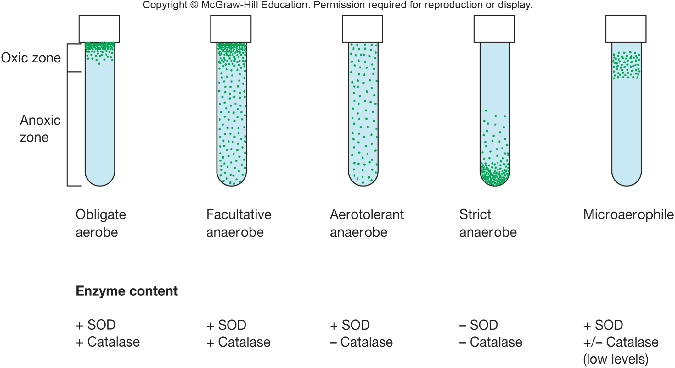
Effects of Different Oxygen Levels on Microbe Growth

Slide 33
Basis of Different Oxygen Sensitivities
Oxygen reduced to reactive oxygen species (ROS)
superoxide radical
hydrogen peroxide
hydroxyl radical
Aerobes produce protective enzymes
superoxide dismutase (SOD)
catalase
peroxidase

Slide 34
Strict Anaerobic Microbes
Strict anaerobic microbes lack/have very low quantities of
superoxide dismutase
Catalase
These microbes cannot tolerate O₂
Anaerobes must be grown without O₂

Slide 35
Pressure
Microbes that live on land and water surface live at 1 atmosphere (atm)
Some Bacteria and Archaea live in deep sea with very high hydrostatic pressures
Barotolerant
adversely affected by increased pressure, but not as severely as nontolerant organisms
Barophilic (peizophilic) organisms
require or grow more rapidly in the presence of increased pressure
change membrane fatty acids to adapt to high pressures

Slide 36
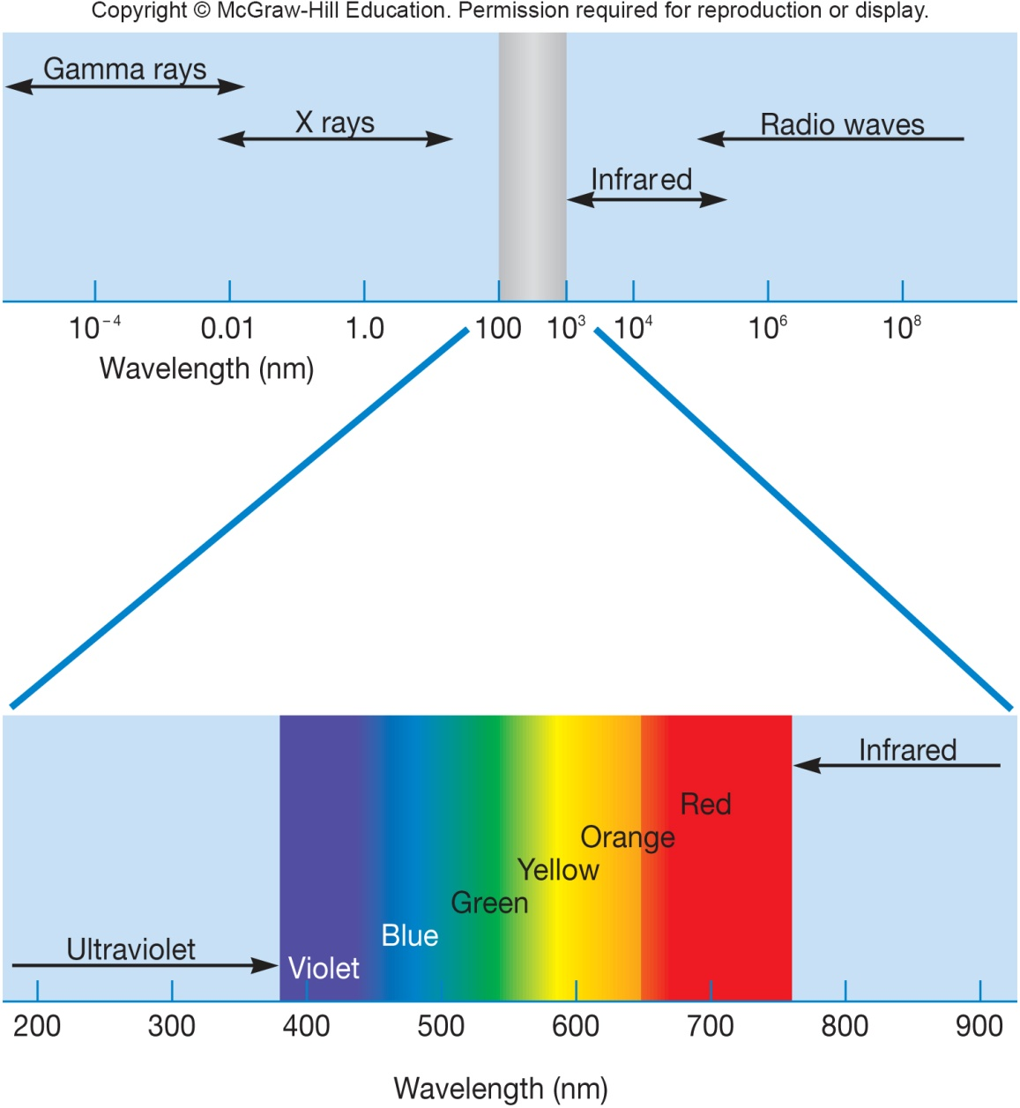
The Electromagnetic Spectrum

Slide 37
Radiation Damage – Ionizing
Ionizing radiation
x-rays and gamma rays
mutations → death (sterilization)
disrupts chemical structure of many molecules, including DNA
damage may be repaired by DNA repair mechanisms if small dose
Deinococcus radiodurans
extremely resistant to DNA damage

Slide 38
Radiation Damage – UV and Visible Light
Ultraviolet (UV) radiation
wavelength most effectively absorbed by DNA is 260 nm
mutations → death
causes formation of thymine dimers in DNA
requires direct exposure on microbial surface
DNA damage can be repaired by several repair mechanisms
Visible light
at high intensities generates singlet oxygen (¹O₂)
powerful oxidizing agent
carotenoid pigments
protect many light-exposed microorganisms from photooxidation

Slide 39
7.5 Microbial Growth In Natural Environments
Discuss the mechanisms used by microbes to survive starvation
Distinguish sessile and planktonic microbial life styles
Describe the formation of biofilms and summarize their importance in natural environments, industrial settings, and medicine
Define quorum sensing and provide examples of cellular processes regulated by quorum sensing
Discuss in general terms the communication that occurs between rhizobia and their plant hosts

Slide 40
Microbial Growth in Natural Environments
Microbial environments are complex, constantly changing, often contain low nutrient concentrations (oligotrophic environment) and may expose a microorganism to overlapping gradients of nutrients and environmental factors

Slide 41
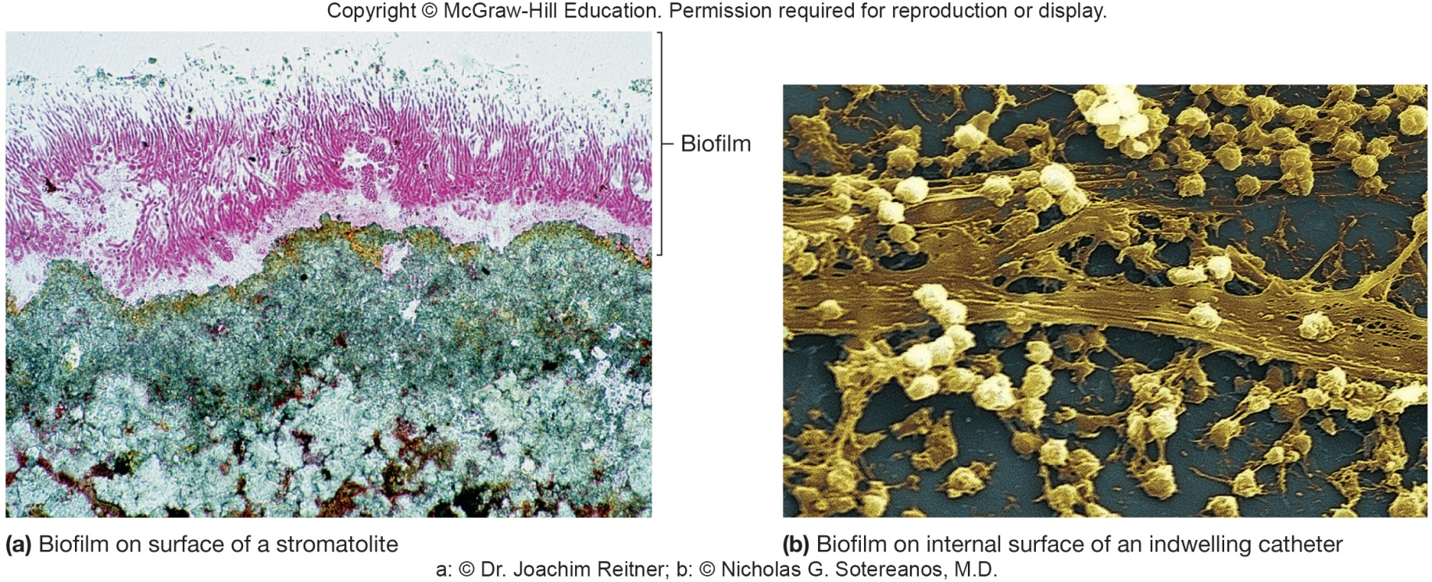
Biofilms
Most microbes grow attached to surfaces (sessile) rather than free floating (planktonic)
These attached microbes are members of complex, slime enclosed communities called a biofilm
Biofilms are ubiquitous in nature in water
Can be formed on any conditioned surface

Slide 42
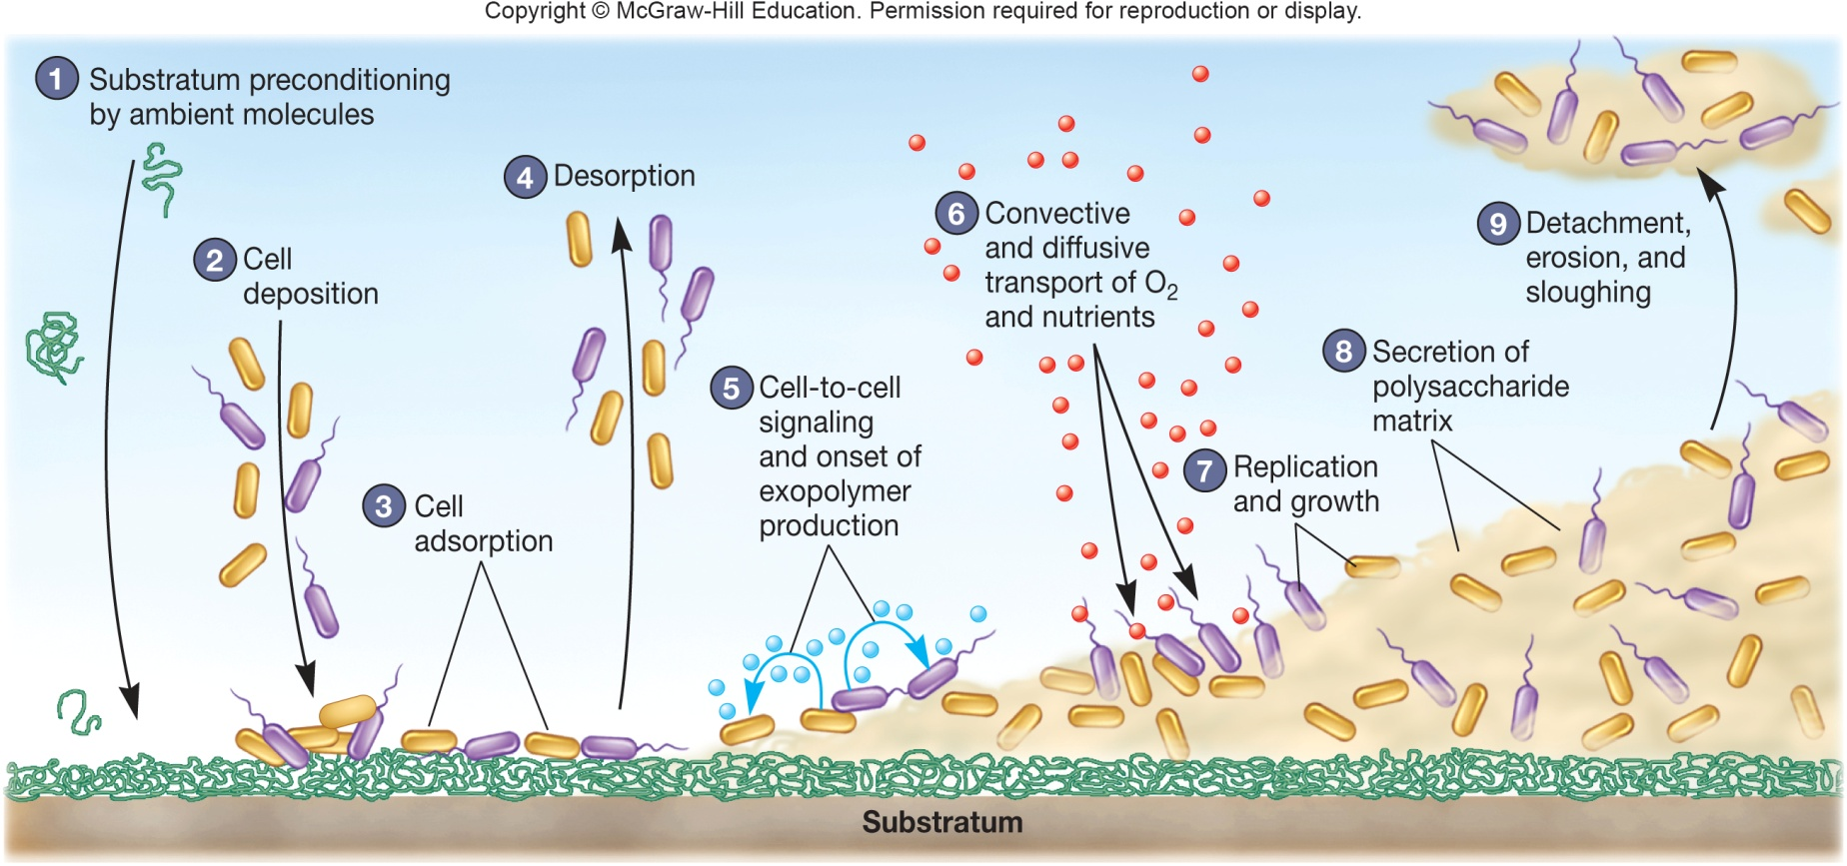
Biofilm Formation
Microbes reversibly attach to conditioned surface and release polysaccharides, proteins, and DNA to form the extracellular polymeric substance (EPS)
Additional polymers are produced as microbes reproduce and biofilm matures

Slide 43
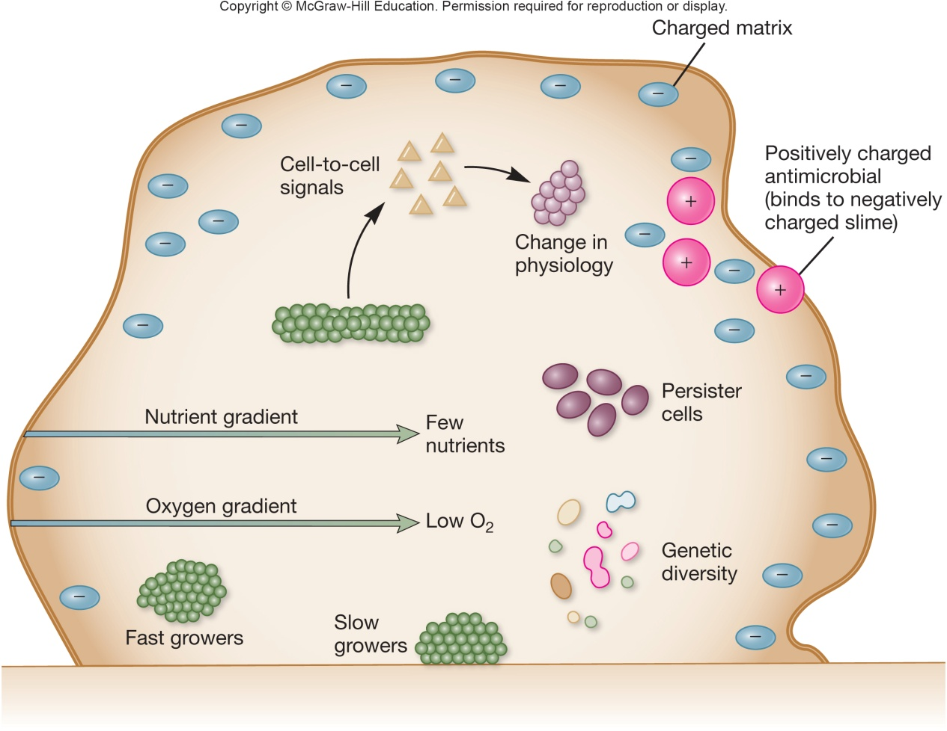
Heterogeneity in Biofilms
A mature biofilm is a complex, dynamic community of microorganisms
Heterogeneity is differences in metabolic activity and locations of microbes
Interactions occur among the attached organisms
exchanges take place metabolically, DNA uptake and communication

Slide 44
Biofilm Microorganisms
The EPS and change in attached organisms’ physiology protects microbes from harmful agents
When formed on medical devices, such as implants, illness can result
Organism sloughing can contaminate water phase above biofilm such as in a drinking water system

Slide 45
Cell to Cell Communication Within the Microbial Populations
Bacterial cells in biofilms communicate in a density-dependent manner called quorum sensing
Produce small proteins that increase in level as microbes replicate and convert a microbe to a competent state
DNA uptake occurs, bacteriocins are released

Slide 46
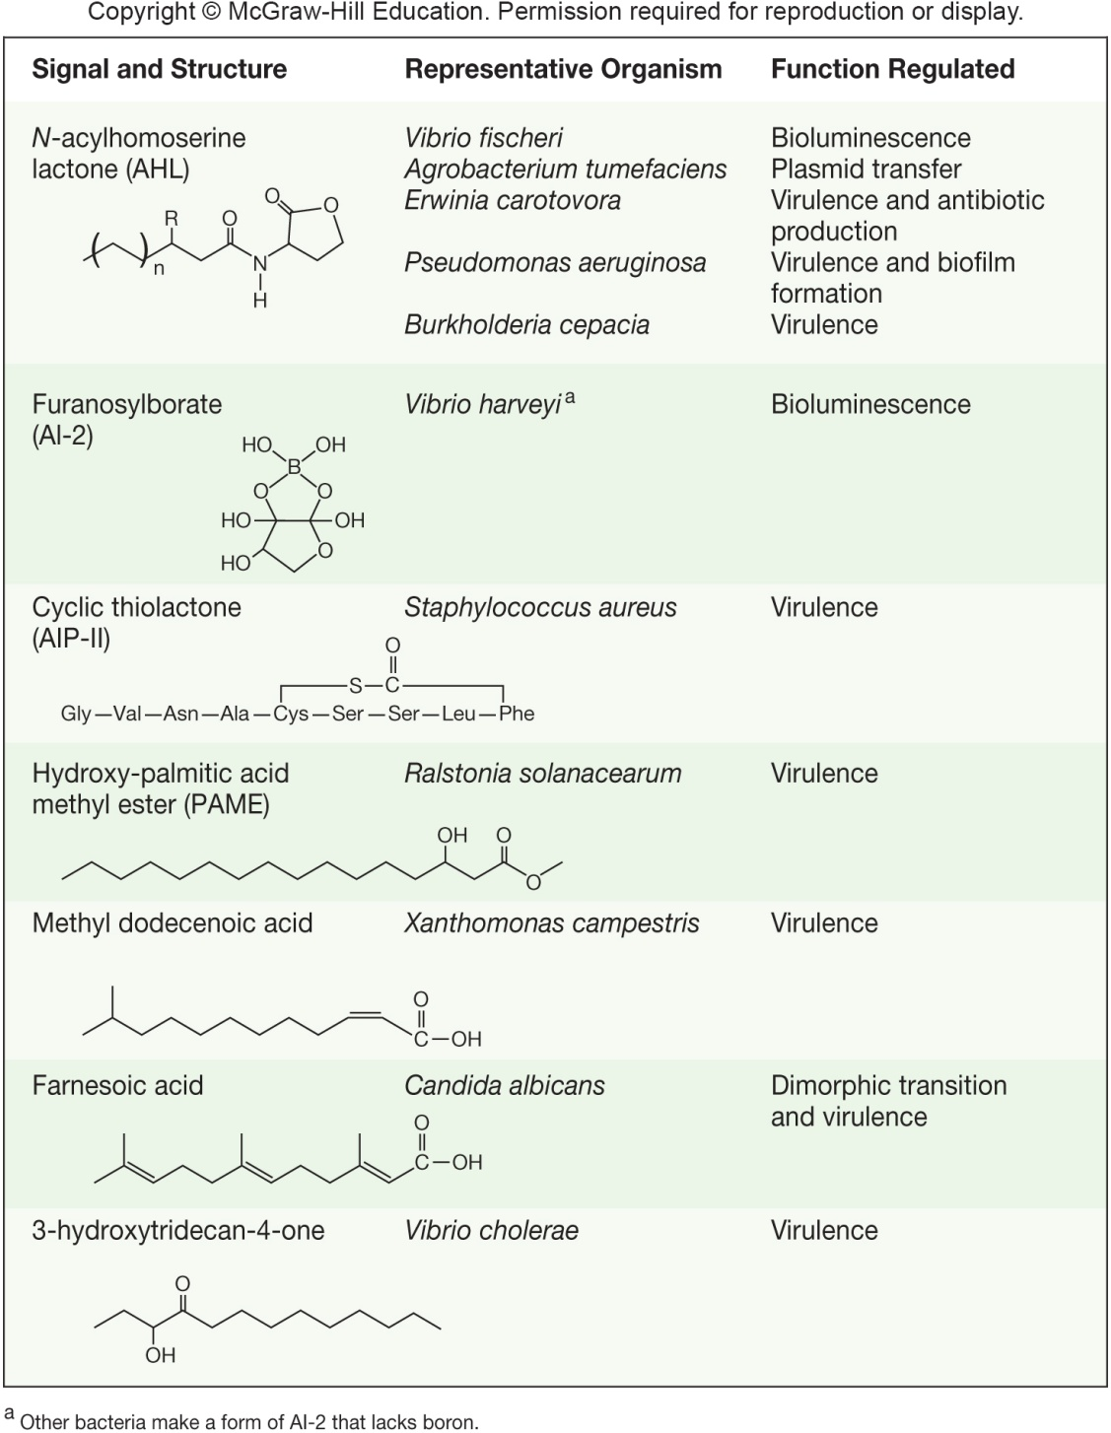
Quorum Sensing
Acylhomoserine lactone (AHL) is an autoinducer molecule produced by many gram-negative organisms
diffuses across plasma membrane
once inside the cell, induces expression of target genes regulating a variety of functions

Slide 47
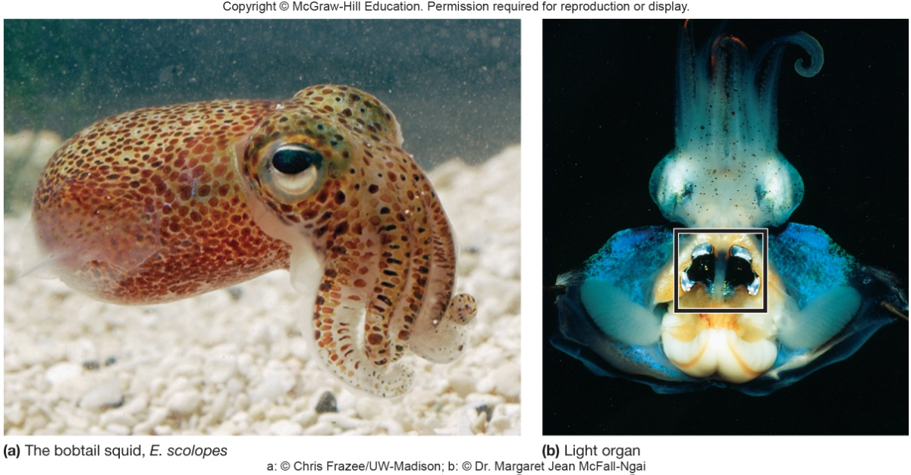
Quorum Sensing Systems
Processes regulated by quorum sensing involve host-microbe interactions
symbiosis – Vibrio fischeri and bioluminescence in squid
pathogenicity and increased virulence factor production
DNA uptake for antibiotic resistance genes
Interdomain communication
Rhizobium interactions with leguminous plants for nitrogen fixation (flavonoids/NodD/Nod factors)

Slide 48
7.6 Laboratory Culture of Cellular Microbes
Describe the importance of culturing microbes to the study of microorganisms
Distinguish defined (synthetic) media from complex media and the uses of liquid from solid growth media
List the characteristics of agar that make it a particularly useful solidifying agent
Compare and contrast supportive (general purpose), enriched, selective, and differential media, listing examples of each and describing how each is used

Slide 49
7.6 Laboratory Culture of Cellular Microbes - 1
Discuss the use of enrichment cultures in isolating microbes
Differentiate the streak-plate, spread-plate, and pour-plate methods for isolating pure cultures
Use the terms commonly used by microbiologists to describe colony morphology

Slide 50
Culture Media
Need to grow, transport, store microorganisms in lab
Culture media is solid or liquid preparation
Must contain all nutrients organism requires for growth
Classification by chemical constituents, physical nature, function

Slide 51
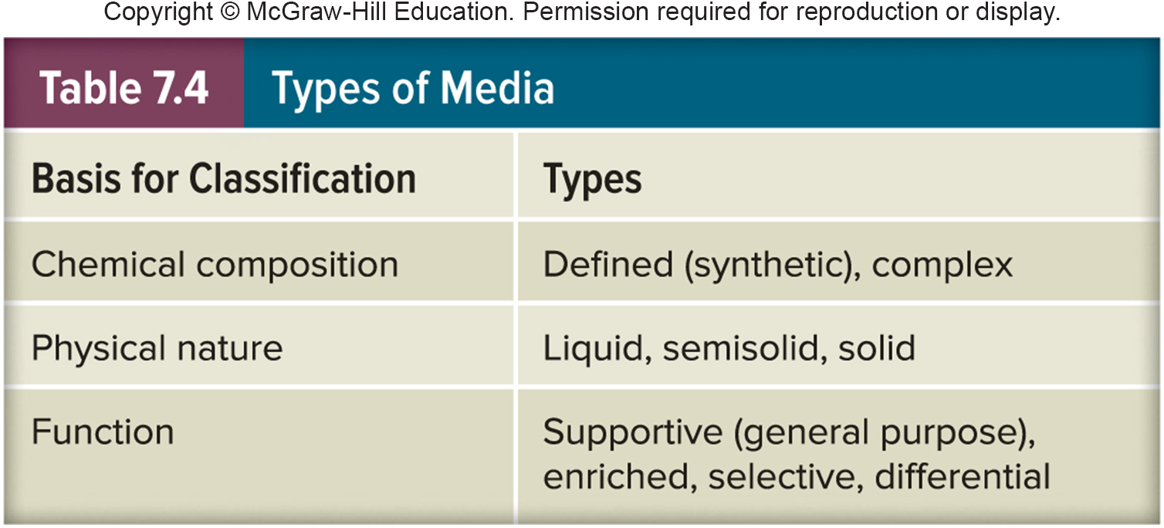
Chemical/Physical Types of Culture Media
Defined/synthetic
Complex

Slide 52
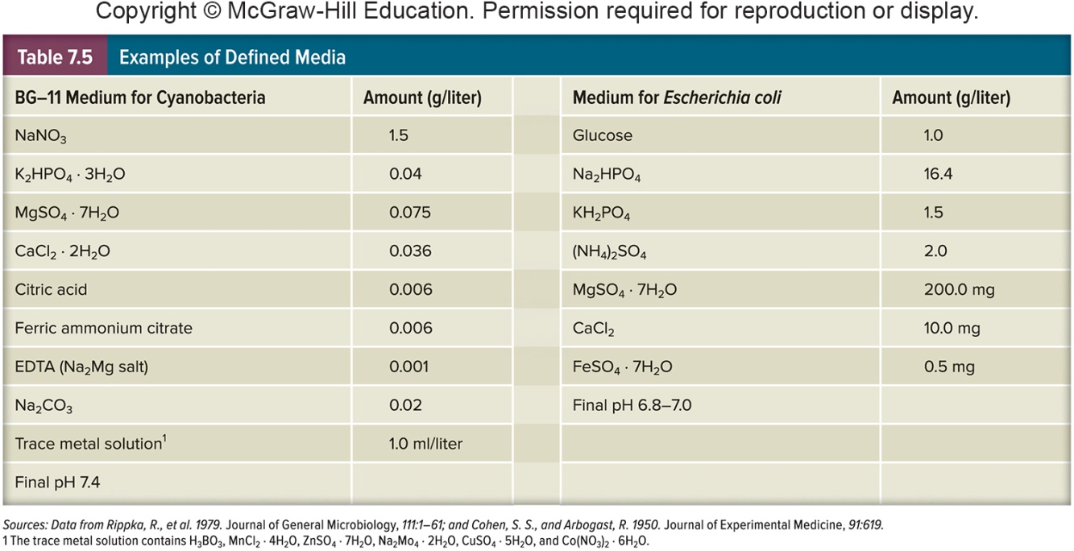
Defined vs. Synthetic Media Examples
Defined or Synthetic Media

Slide 53
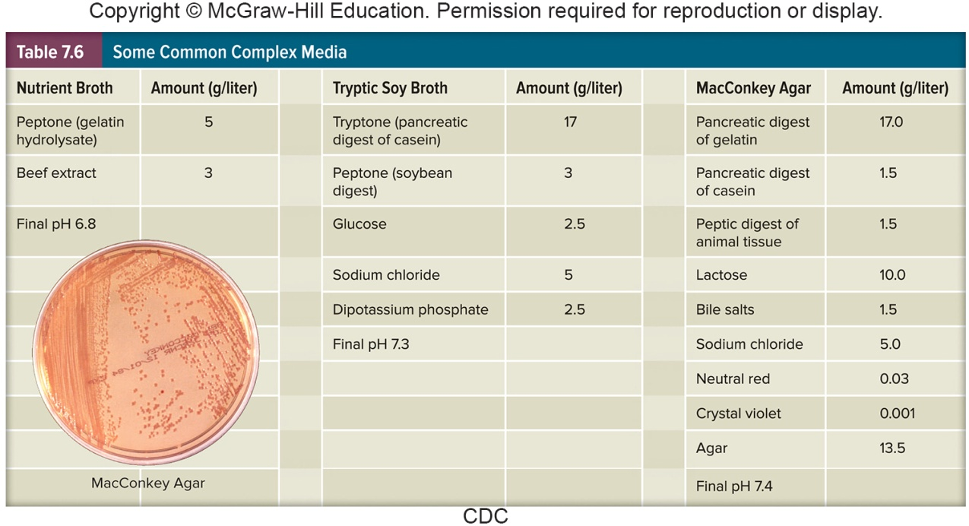
Complex Media

Slide 54
Some Media Components
Peptones - protein hydrolysates from protein sources
Extracts - aqueous extracts, usually of beef or yeast
Agar - sulfated polysaccharide solidifying agent; most microorganisms cannot degrade it

Slide 55
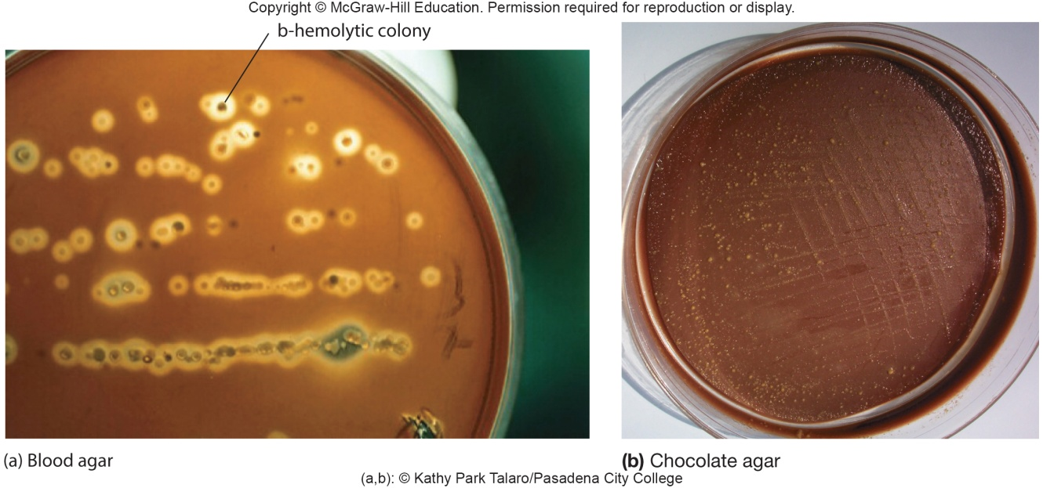
Functional Types of Media
Supportive or general purpose media (e.g. TSA) - support the growth of many microorganisms
Enriched media (e.g. blood agar) – general purpose media supplemented with special nutrients
Selective
Differential

Slide 56
Selective and Differential Media
Selective Media
Favor the growth of some microorganisms and inhibit growth of others
e.g. MacConkey agar
selects for Gram-negative bacteria
Differential Media
Distinguish between different groups of microorganisms based on their biological characteristics
e.g. blood agar
hemolytic versus nonhemolytic bacteria
e.g. MacConkey agar
lactose fermenters versus nonfermenters

Slide 57
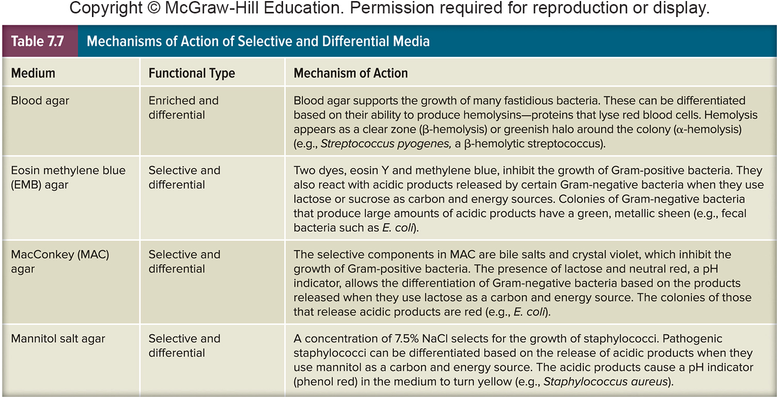
Mechanisms of Action of Media Types

Slide 58
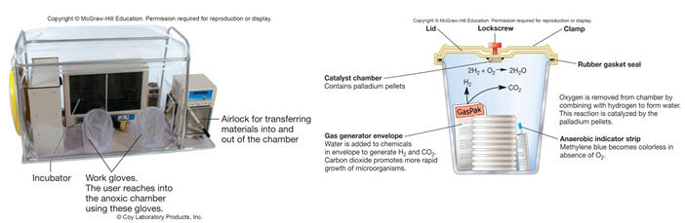
Strict Anaerobic Microbes
All strict anaerobic microorganisms lack or have very low quantities of
superoxide dismutase
Catalase
These microbes cannot tolerate O₂
Anaerobes must be grown without O₂

Slide 59
Isolation of Pure Cultures
Population of cells arising from a single cell developed by Robert Koch
Allows for the study of single type of microorganism in mixed culture
Spread plate, streak plate, and pour plate are techniques used to isolate pure cultures

Slide 60
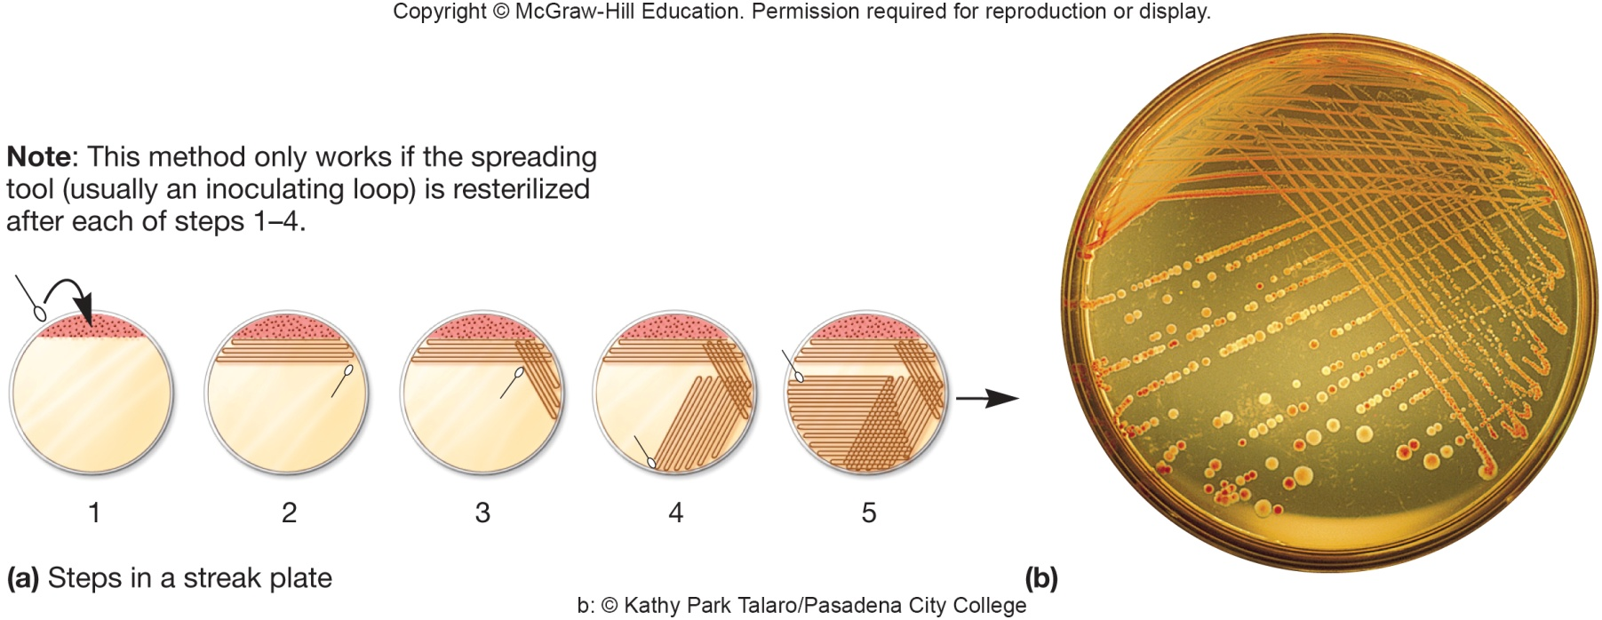
The Streak Plate
Involves technique of spreading a mixture of cells on an agar surface so that individual cells are well separated from each other
involves use of bacteriological loop
Each cell can reproduce to form a separate colony (visible growth or cluster of microorganisms)

Slide 61
The Spread Plate and Pour Plate
Spread plate
small volume of diluted mixture containing approximately 30–300 cells is transferred
spread evenly over surface with a sterile bent rod
Pour plate
sample is serially diluted
diluted samples are mixed with liquid agar
mixture of cells and agar are poured into sterile culture dishes
Both may be used to determine the number of viable microorganisms in an original sample

Slide 62
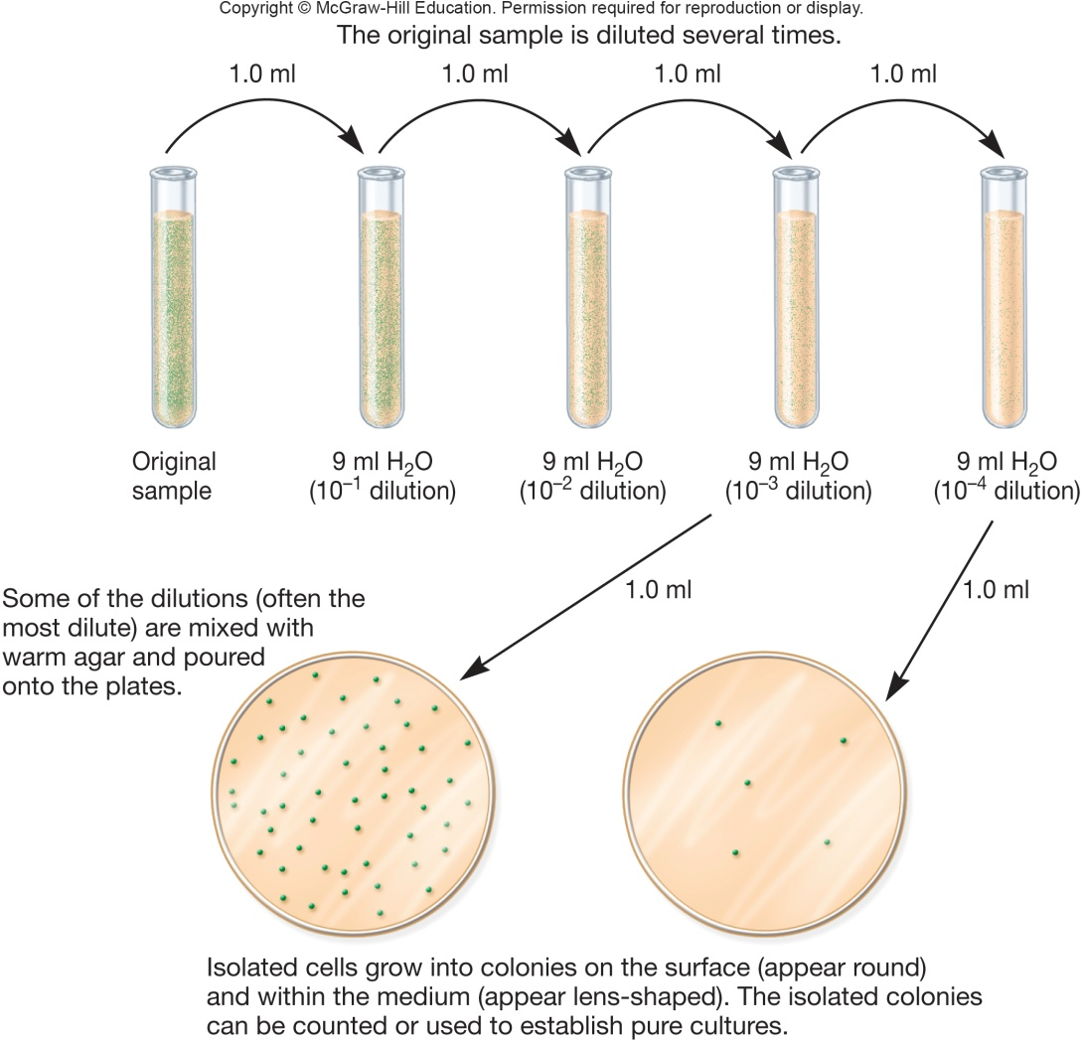
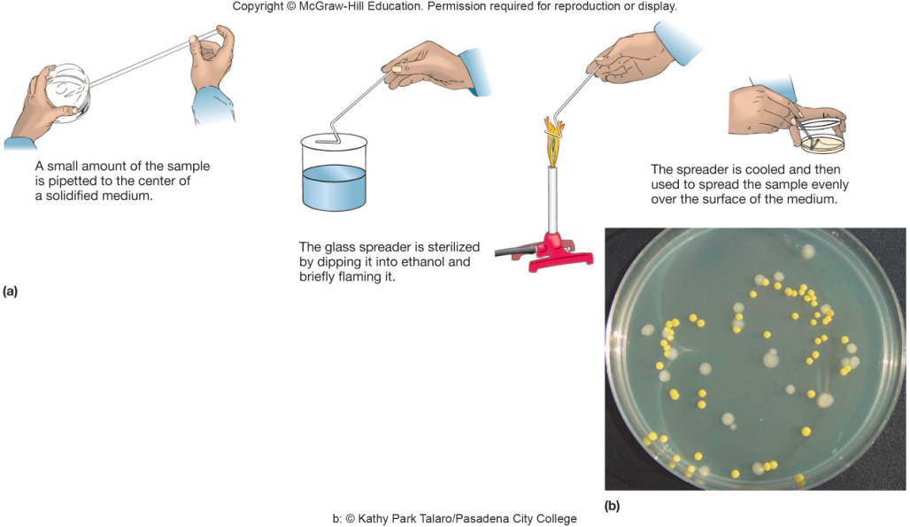
Method for Spread and Pour Plates

Slide 63
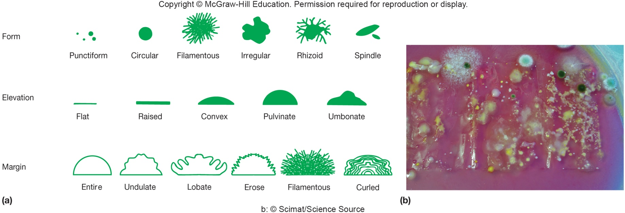
Microbial Growth on Solid Surfaces
Colony characteristics that develop when microorganisms are grown on agar surfaces aid in identification
Microbial growth in biofilms is similar
Differences in growth rate from edges to center is due to
oxygen, nutrients, and toxic products
cells may be dead in some areas

Slide 64
7.7 Growth Curves Consist of Five Phases
Describe the five phases of a microbial growth curve observed when microbes are grown in a batch culture
Describe three hypotheses proposed to account for the decline in cell numbers during the death phase of a growth curve
Predict how the presence of viable but nonculturable cells in food or water systems might impact public health

Slide 65
7.7 Growth Curves Consist of Five Phases - 1
Correlate changes in nutrient concentrations in natural environments with the five phases of a microbial growth curve
Relate growth rate constant to generation (doubling) time and suggest how these values might be used by microbiologists doing basic research or working in industrial settings

Slide 66
Growth
Increase in cellular constituents that may result in:
increase in cell number
increase in cell size
Growth refers to population growth rather than growth of individual cells

Slide 67
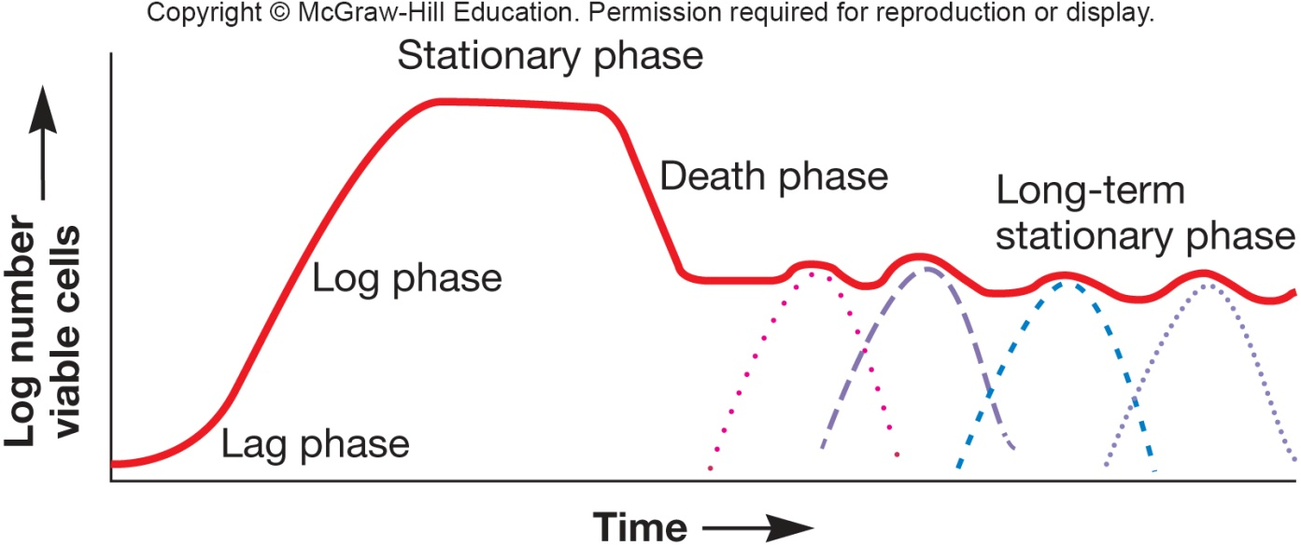
The Growth Curve
Observed when microorganisms are cultivated in batch culture
Usually plotted as logarithm of cell number vs. time
Has five distinct phases

Slide 68
Lag Phase and Exponential Phase
Lag Phase
Cell synthesizing new components
e.g. to replenish spent materials
e.g. to adapt to new medium or other conditions
Varies in length
in some cases can be very short or even absent
Exponential Phase
Also called log phase
Rate of growth and division is constant and maximal
Population is most uniform in terms of chemical and physical properties during this phase

Slide 69
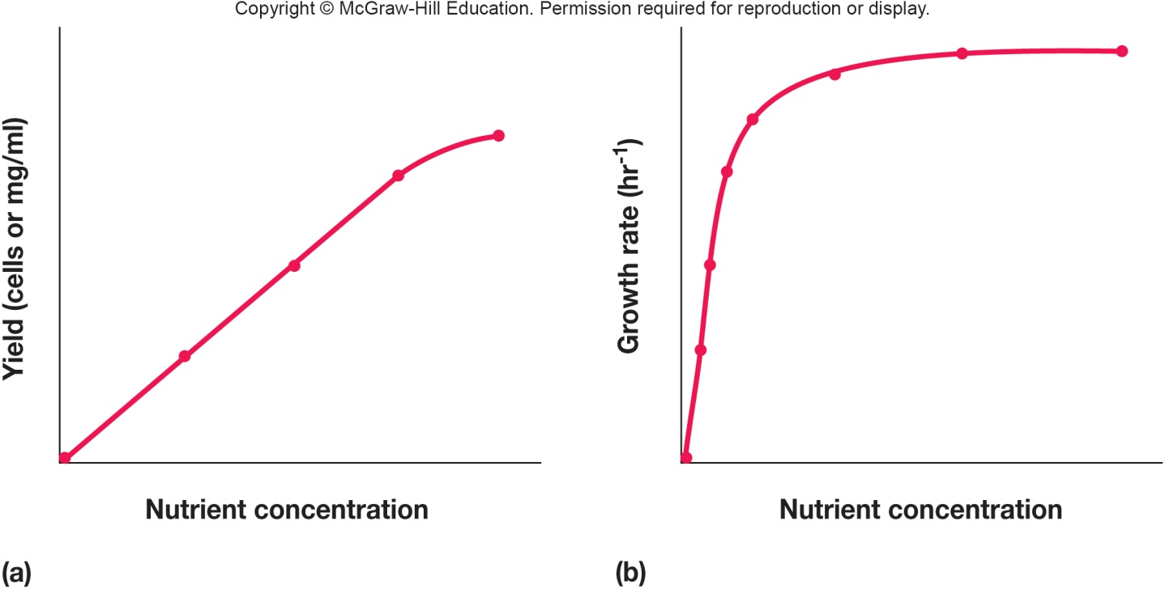
Nutrient Availability and Growth
During log phase, cells grow as quickly as they can for the conditions available
nutrient concentrations may be limiting, limiting growth
abundance of nutrients allows transport mechanisms to be saturated, so growth increase is minimal for adding in even more nutrients

Slide 70
Stationary Phase
Closed system population growth eventually ceases, total number of viable cells remains constant
active cells stop reproducing or reproductive rate is balanced by death rate
Possible reasons for stationary phase
nutrient limitation
limited oxygen availability
toxic waste accumulation
critical population density reached

Slide 71
Death Phase and Prolonged Decline in Growth
Death Phase
Two alternative hypotheses
cells are Viable But Not Culturable (VBNC)
cells alive, but dormant, capable of new growth when conditions are right
programmed cell death
fraction of population genetically programmed to die (suicide)
Prolonged Decline in Growth
Bacterial population continually evolves
Process marked by successive waves of genetically distinct variants
Natural selection occurs

Slide 72
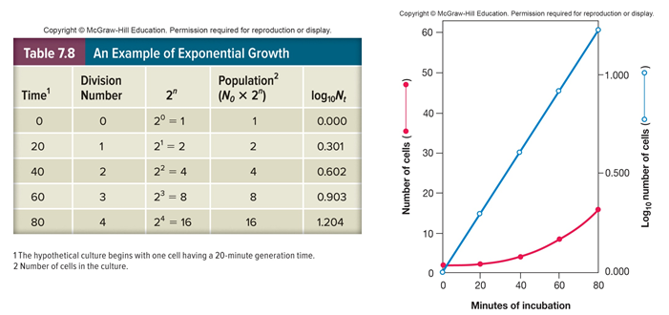
The Mathematics of Growth
Generation (doubling) time
time required for the population to double in size
varies depending on species of microorganism and environmental conditions
range from 10 minutes for some
bacteria to days for some eukaryotes

Slide 73
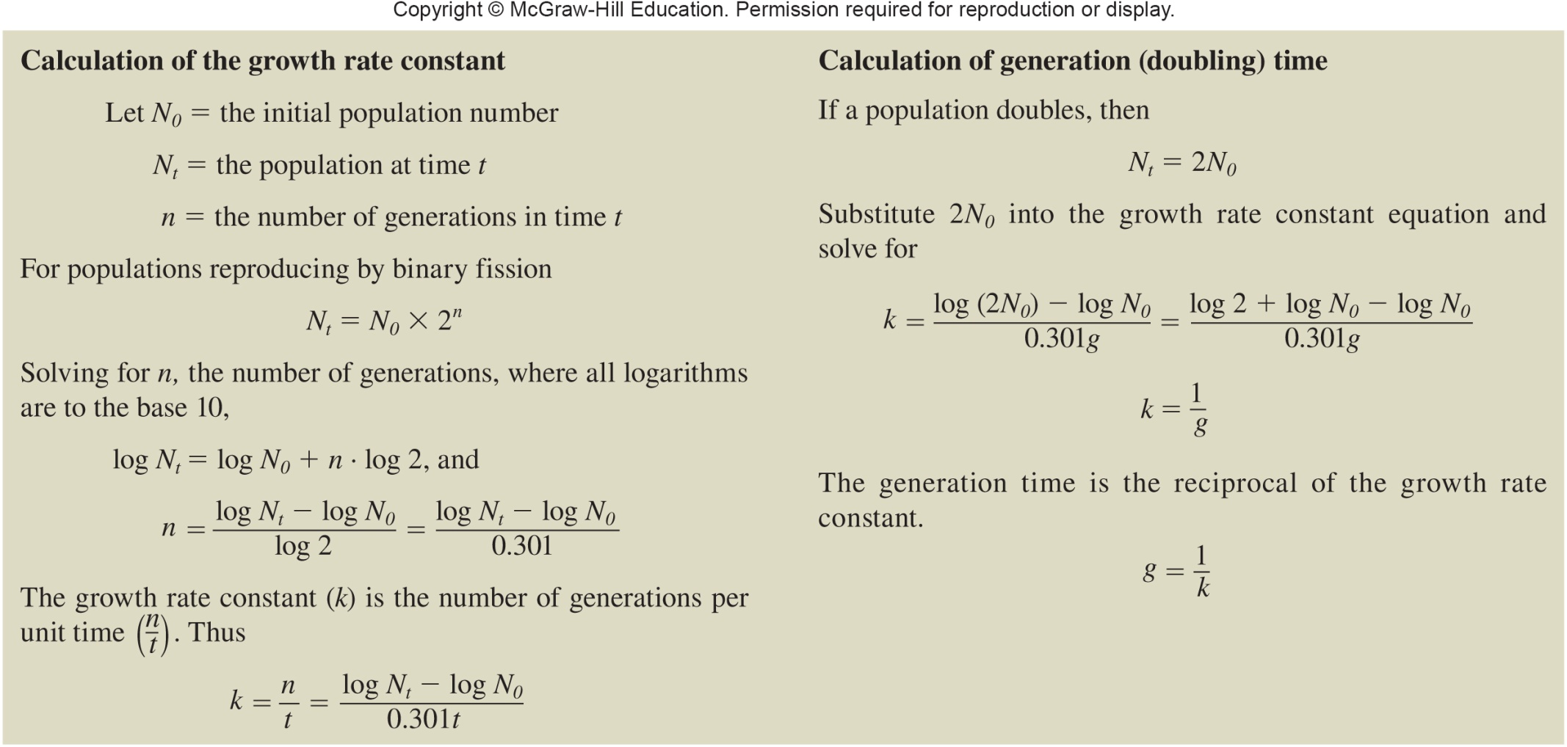
Measurement of Growth Rate and Generation Time

Slide 74
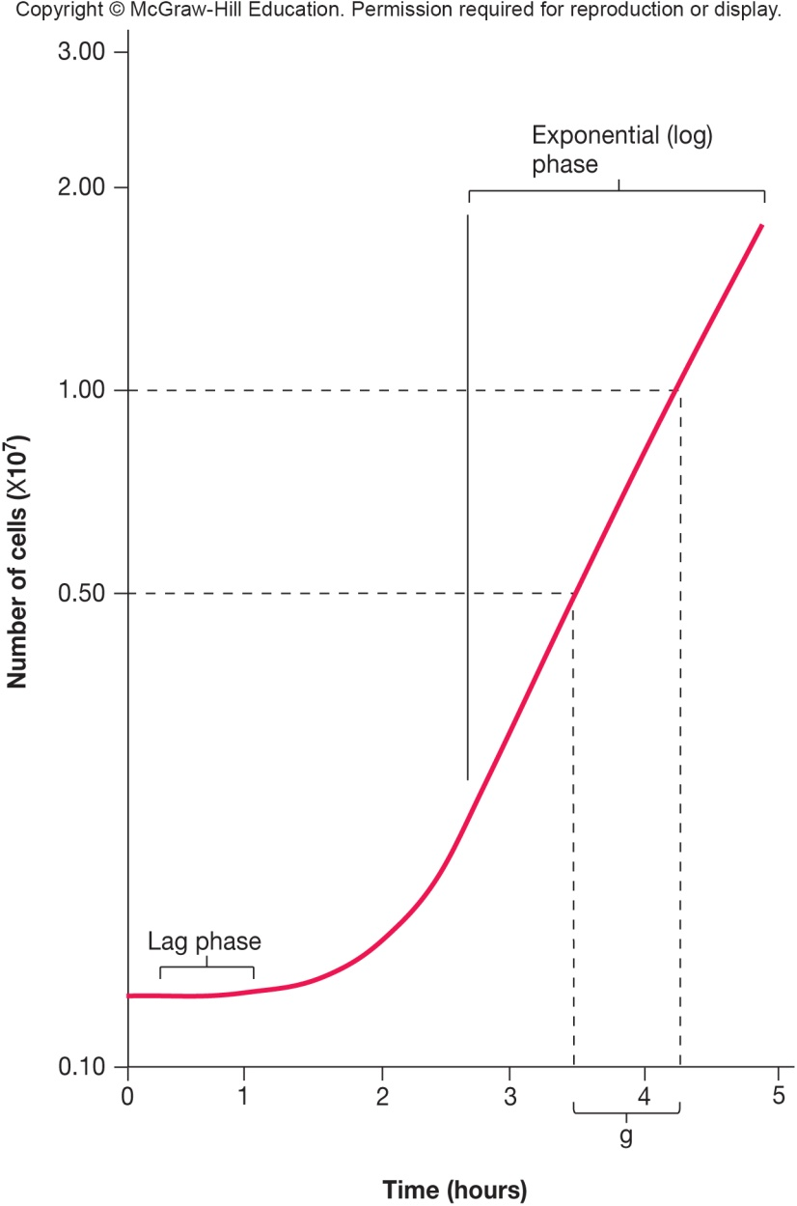
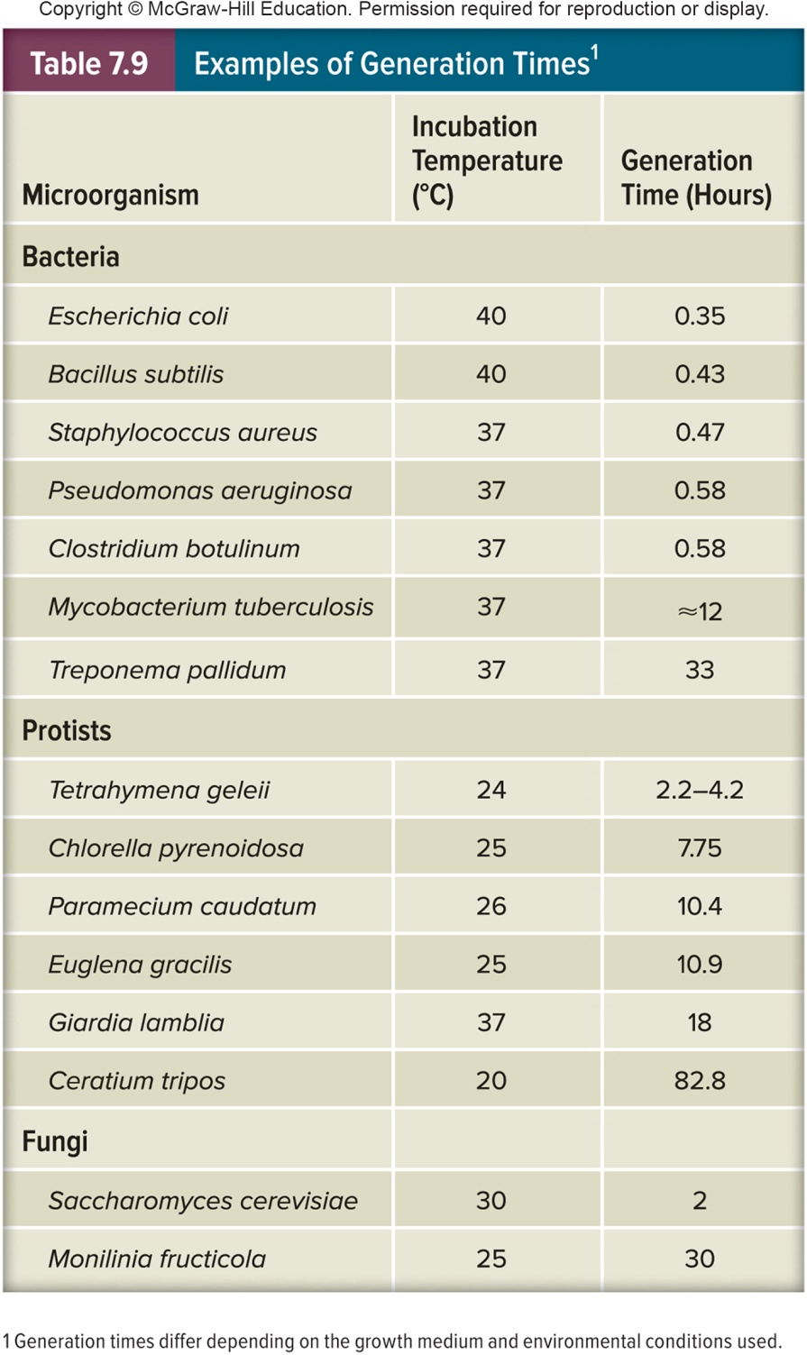
Outcomes of Gen. Time Calculations

Slide 75
7.8 Microbial Population Size Can Be Measured Directly or Indirectly
Evaluate direct cell counts, viable counting methods, and cell mass measurements for determining population size
Explain why plate count results are expressed in terms of colony forming units (CFUs)
Design appropriate approaches for measuring the population size of different types of samples

Slide 76
Measurement of Microbial Growth and Direct Measurement of Cell Numbers
Measurement of Microbial Growth
Can measure changes in number of cells in a population
Can measure changes in mass of population
Direct Measurement of Cell Numbers
Direct cell counts
counting chambers
electronic counters – flow cytometry
on membrane filters

Slide 77
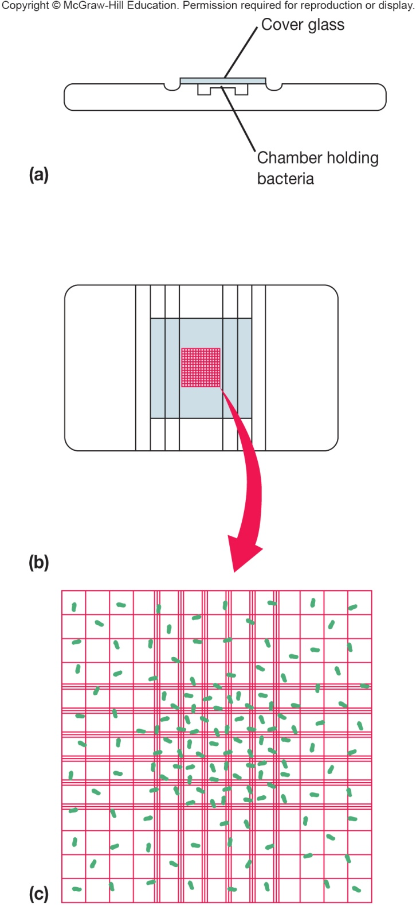
Counting Chambers
Easy, inexpensive, and quick
Useful for counting both eukaryotes and prokaryotes
Cannot distinguish living from dead cells

Slide 78
Direct Counts on Membrane Filters
Cells filtered through special membrane that provides dark background for observing cells
Cells are stained with fluorescent dyes
Useful for counting bacteria
With certain dyes, can distinguish living from dead cells

Slide 79
Flow Cytometry
Microbial suspension forced through small orifice with a laser light beam
Movement of microbe through orifice impacts electric current that flows through orifice
Instances of disruption of current are counted
Specific antibodies can be used to determine size and internal complexity

Slide 80
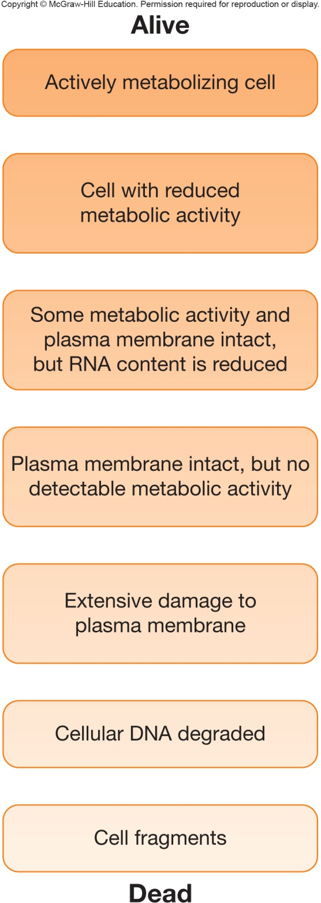
Viable counting: Alive or dead?
Whether or not a cell is alive or dead isn’t always clear cut in microbiology
cells can exist in a variety of states between ‘fully viable’ and ‘actually dead’

Slide 81
Viable Counting Methods – Spread/Pour Plates
Spread and pour plate techniques
diluted sample of bacteria is spread over solid agar surface or mixed with agar and poured into Petri plate
after incubation the numbers of organisms are determined by counting the number of colonies multiplied by the dilution factor
results expressed as colony forming units (CFU)

Slide 82
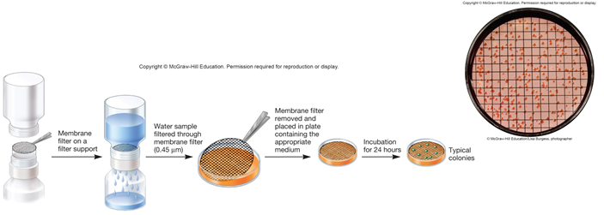
Viable Counting Methods – Membrane Filter Method
Membrane filter (0.2-0.45 micrometer pore size) technique
bacteria from aquatic samples are trapped on membranes
membrane soaked in culture media
colonies grow on membrane
colony count determines # of bacteria in sample

Slide 83
Viable Counting Methods – MPN Method
If microbe cannot be cultured on plate media
Dilutions are made and added to suitable media
Turbidity determined to yield the most probable number (MPN)

Slide 84
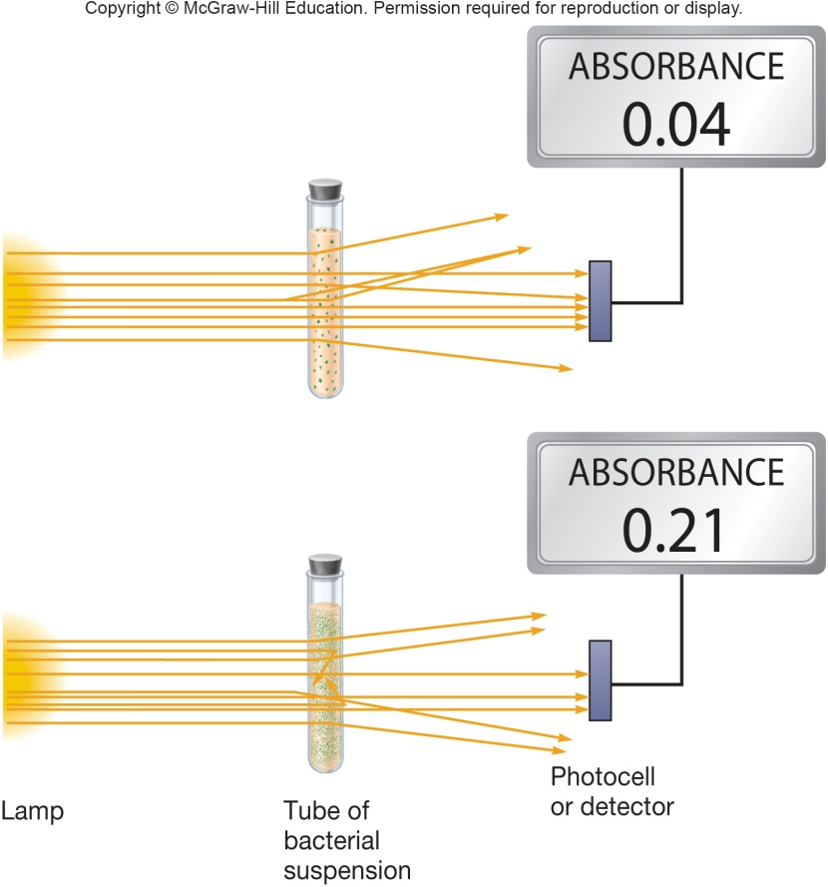
Measurement of Cell Mass
Dry weight
time consuming and not very sensitive
Quantity of a particular cell constituent
e.g., protein, DNA, ATP, or chlorophyll
useful if amount of substance in
each cell is constant
Turbidometric measures (light
scattering)
quick, easy, and sensitive

Slide 85
7.9 Chemostats and Turbidostats Are Used for Continuous Culture of Microorganisms
Distinguish batch culture and continuous culture
Differentiate chemostats and turbidostats
Discuss the relationship between the dilution rate of a chemostat and population size and growth rate

Slide 86
The Continuous Culture of Microorganisms
Growth in an open system
continual provision of nutrients
continual removal of wastes
Maintains cells in log phase at a constant biomass concentration for extended periods
Achieved using a continuous culture system
Constant supply of cells in exponential phase growing at a known rate
study of microbial growth at very low nutrient concentrations, close to those present in natural environment
study of interactions of microbes under conditions resembling those in aquatic environments
food and industrial microbiology

Slide 87
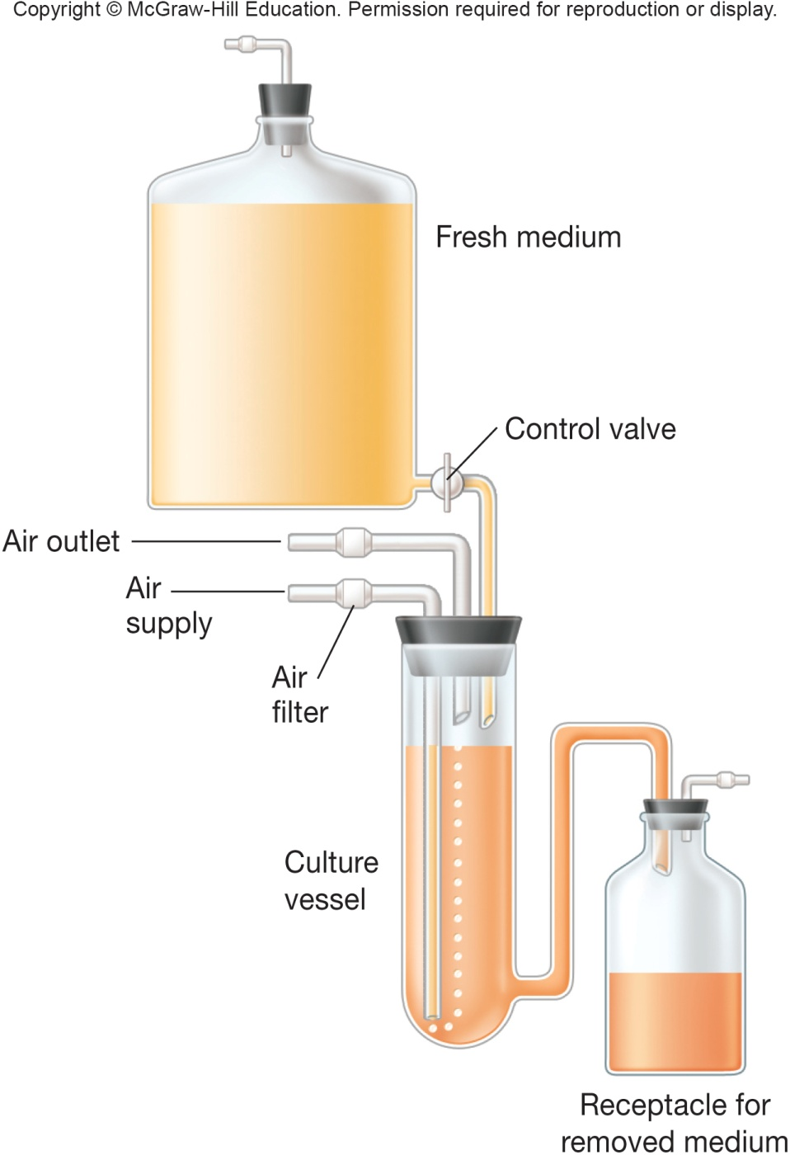
The Chemostat and The Turbidostat
The Chemostat
Rate of incoming medium = rate of removal of medium from vessel
An essential nutrient is in limiting quantities
The Turbidostat
Regulates flow rate of media through vessel to maintain predetermined turbidity or cell density
Dilution rate varies
No limiting nutrient
Turbidostat operates best at high dilution rates

Slide 88
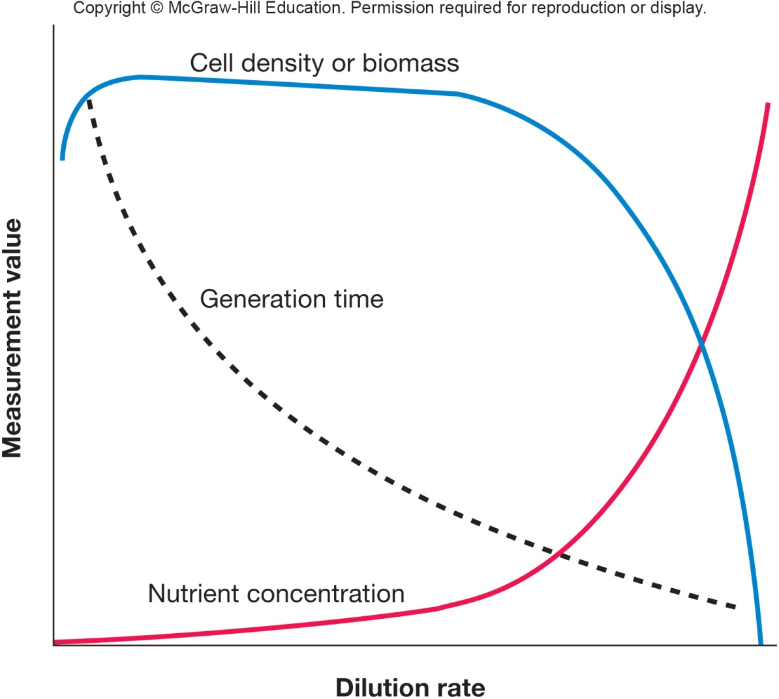
Dilution Rate and Microbial Growth
Dilution rate – rate at which medium flows through vessel
Relative to vessel size
Note: cell density maintained at wide range of dilution rates
Chemostat operates best at low dilution rate

Slide 89
Take Home Message
Understanding how microbes grow is important to eventually either controlling or encouraging that growth for our own purposes
The idea here is to get a better feeling for what parameters will impact the growth of different microbes, for better and for worse
Always be thinking about conditions that could affect the growth of microbes in an area – whether you want to grow them (in the lab, for instance) or want to shut their growth down (in a patient, for instance)
This chapter also takes you through counting methods. Make sure you’re aware of how microbes can be counted up – knowing how many are present is an important piece of information

